Slide 1
Invest: safe-tee
by Madeleine Dwyer, Wen Fan, Ziye Hu, Yanting Liu,
Baiting Luo, Adam Platek, Kangning Wang and Yuheng Zhou

Slide 2
Agenda
Introduction & Problem Statement
Customer Needs & Requirements
Performance Specifications
Risk assessment
Team Skills
Design Alternative
Concept Selection
Prototype Subsystem Design
Prototype Design
Comparison between
Prototype and Final Design
Testing
Complications
Production Ramp Up
Review & Reflect
Validation through
Customer Requirements
What We Learned
Conclusion
References

Slide 3
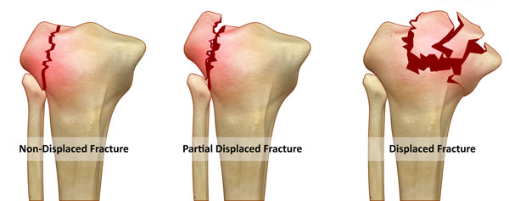

Introduction
37.7 million people on average fall and require medical attention each year (12%)!
424,000 people die each year from fall-related injuries.
[24]
Displacement Fracture of Knee Joint
References: 52.

Slide 4
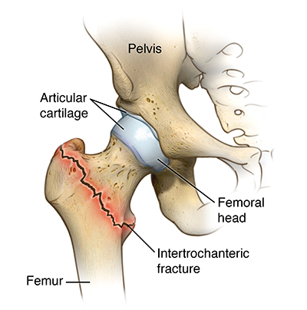
Problem statement
2/3 of victims will fall a second time within 6 months
1/4 of elders who fall and fracture a hip will die within 6 months.
Target customer: elderly (65+), disabled, and therapy patients
[27]
Displacement Fracture of Hip Joint
References: 41.

Slide 5
Customer Requirements
Safety
Maximum Weight Limit
Comfort
Suitable Size
Plate Location
stomach, shoulder, rib, heart, hip plates
Sufficient Catch Height
at least .91 meters
890 Newtons
Affordable & Fashionable
standard unisex sizes (cm) Medium - Chest (96-102), Waist - (81-84)
Suitable Weight
Max 89 Newtons
Temperature Moderation
At least 4 holes, >3 ventilation areas additional
Ease of Use
Number of Parts
10 max
Time to assemble
20 minutes max
Time to reassemble
5 minutes max
Time to put on
3 minutes max
Percent Shrinkage
assuming washable, less than 5%
Percent Dampness
0% water reaching sensors
Purchase cost
< $500 (subjective to change of cost analysis)
Maintenance cost
< $50 monthly
Color
Subjective
Shape
Subjective

Slide 6
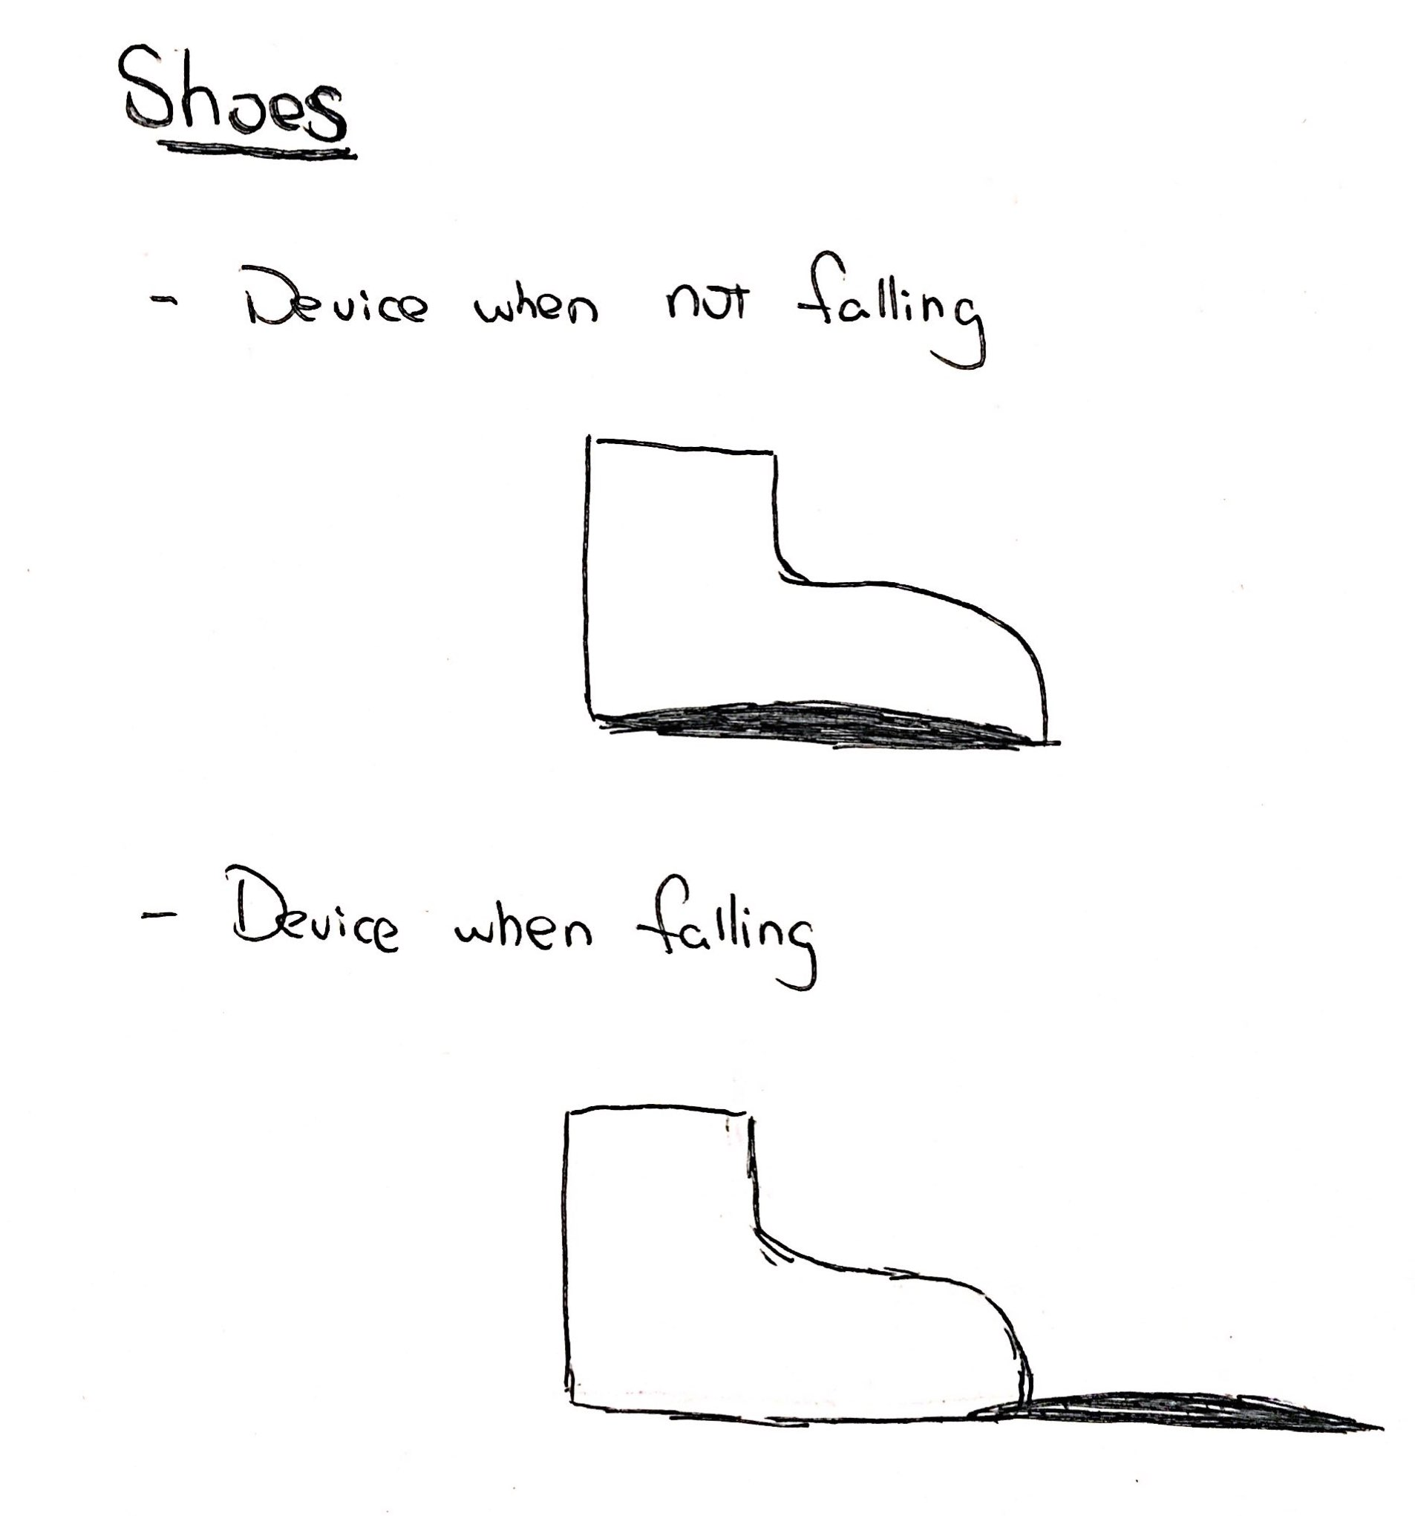
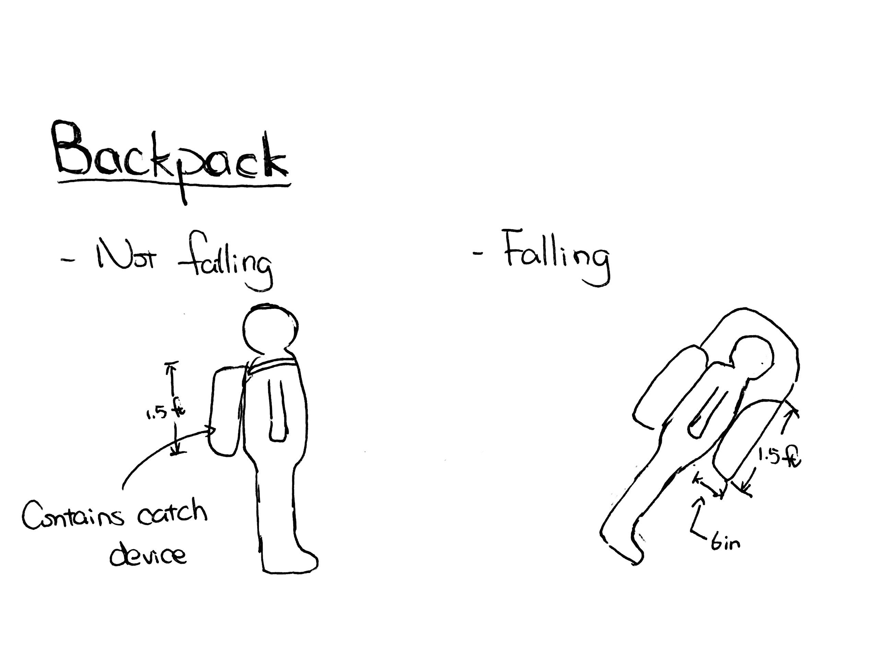
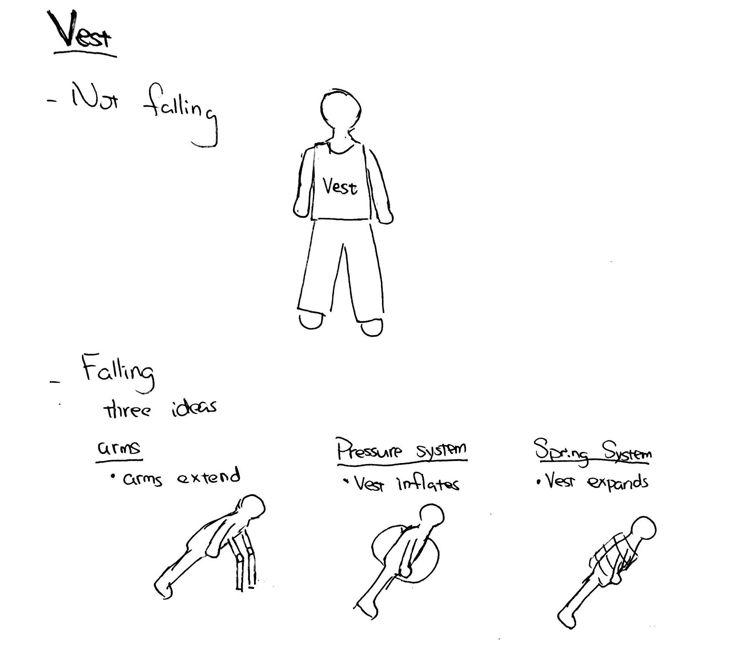
System Design Alternatives
Shoe Design
Backpack Design
Vest Design
Concept Score: 35.9
Concept Score: 36.9
Concept Score: 67

Slide 7
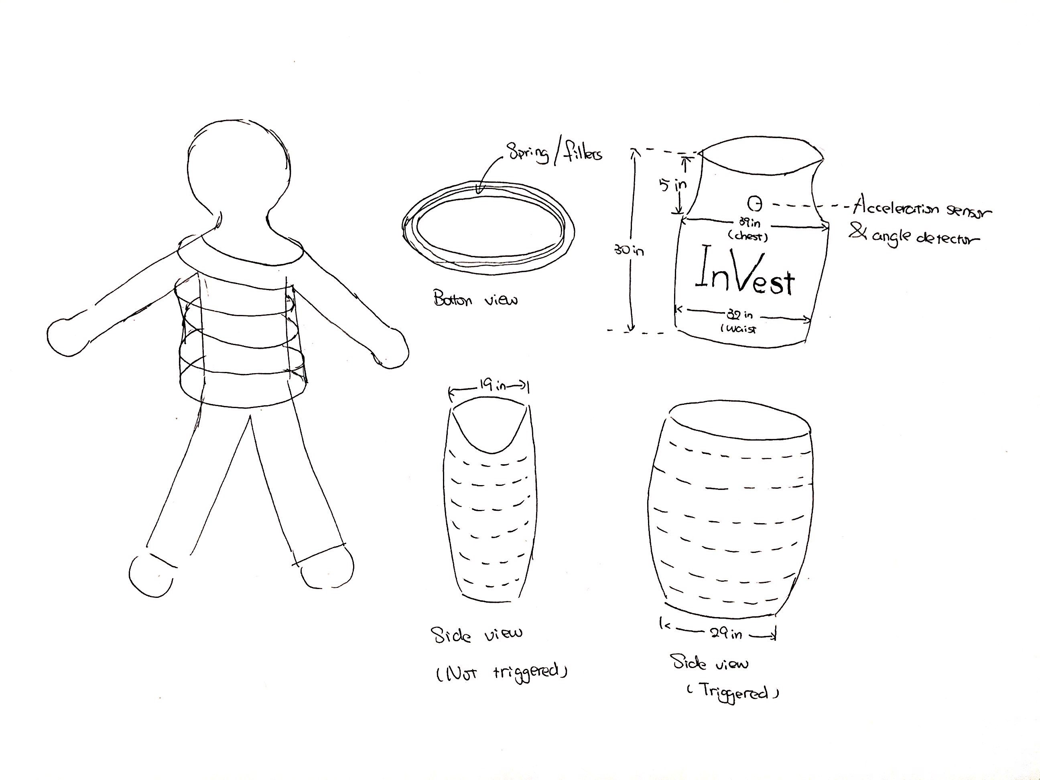
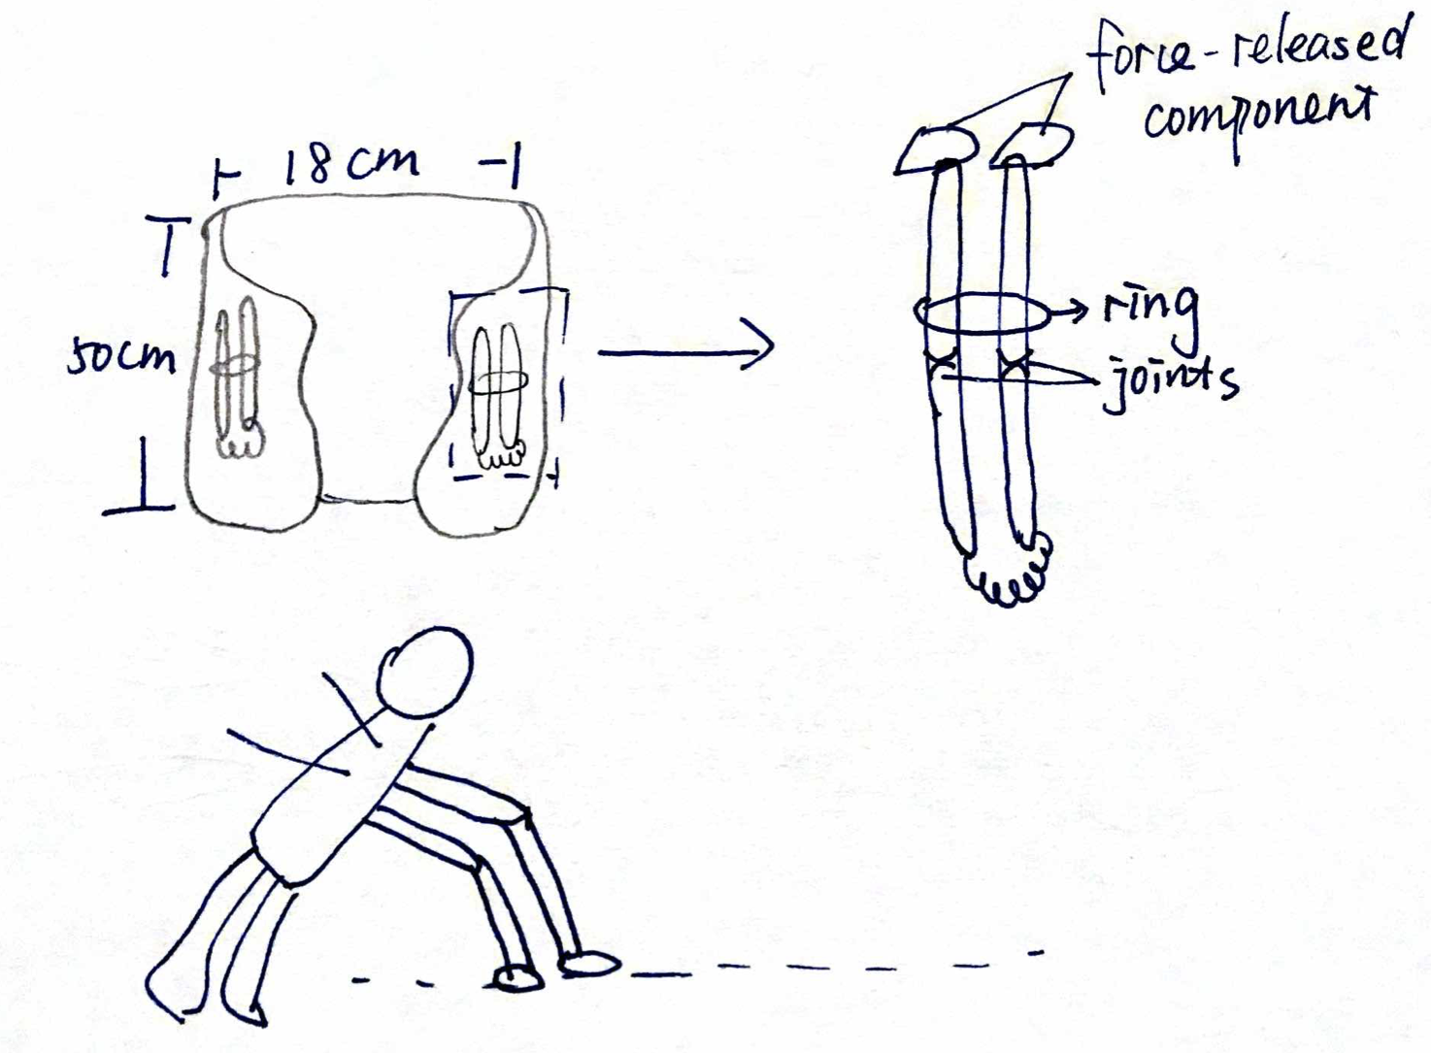
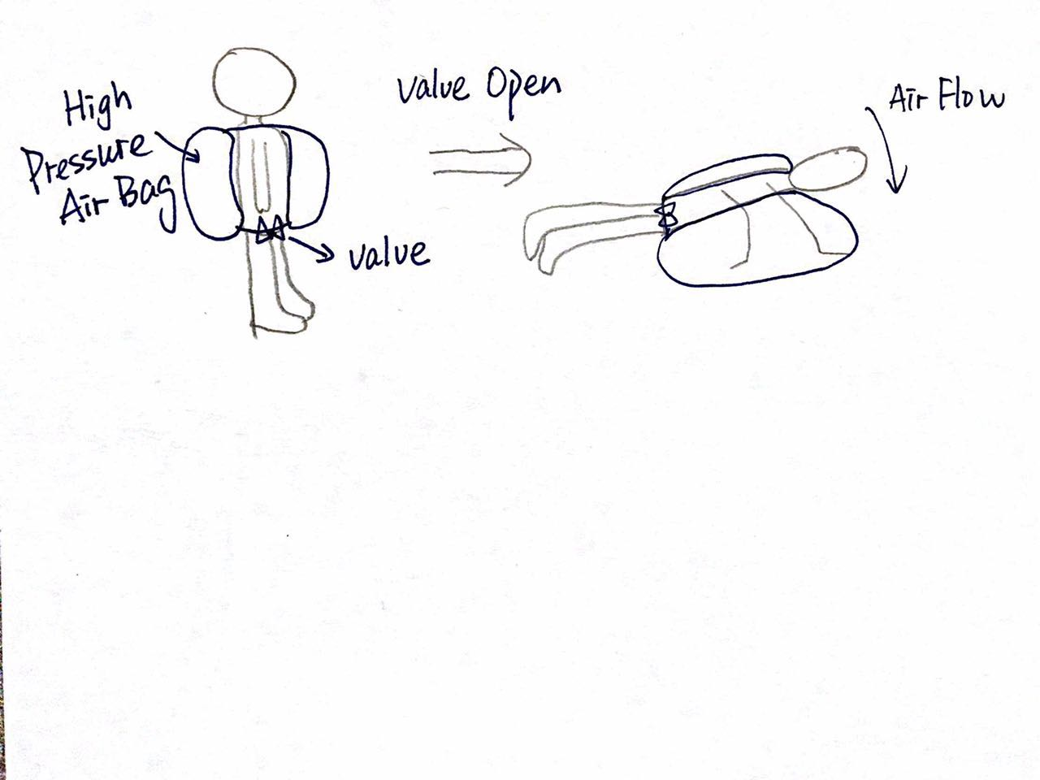
Vest Design Alternatives
Spring Design
Airbag Design
Arm Design
Concept Score: 51.3
Concept Score: 49
Concept Score: 65
References: 3.

Slide 8
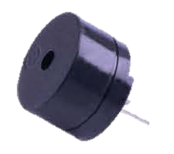
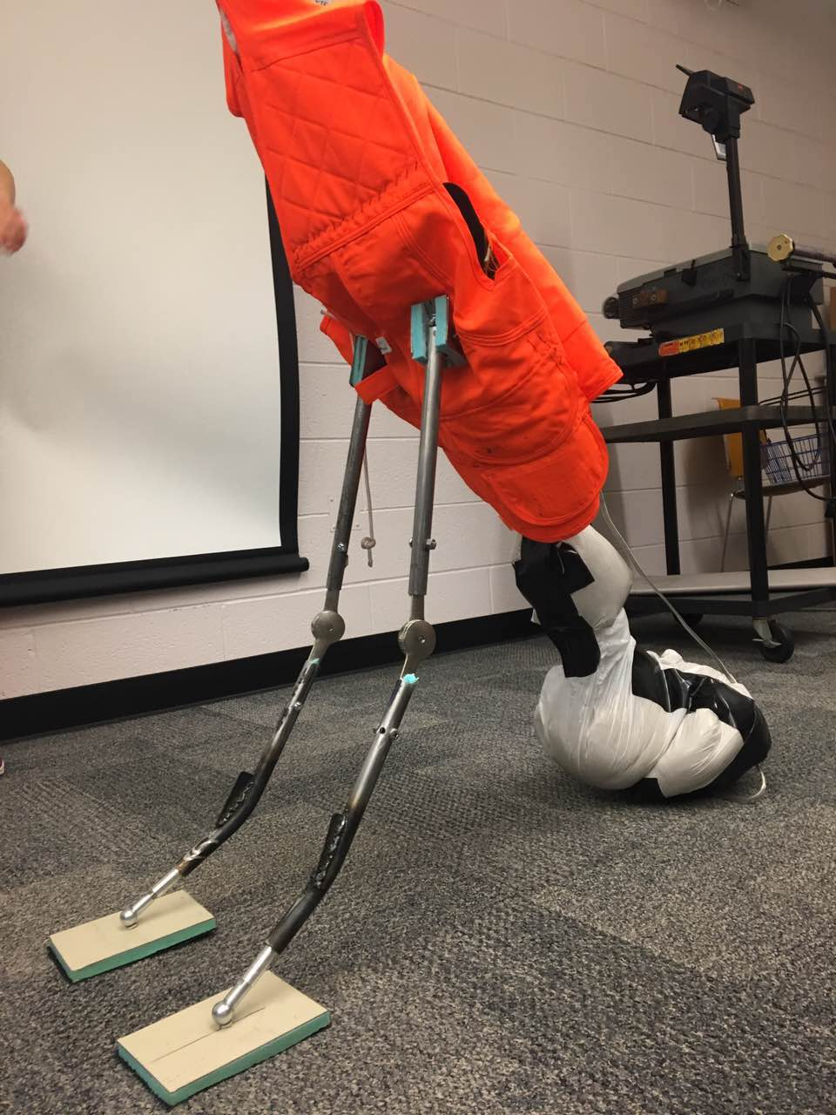
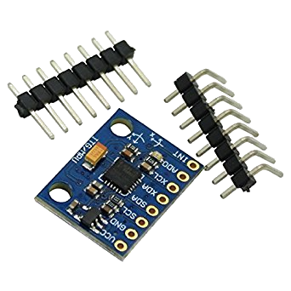
Performance Specifications
Detecting：
Sensor Type: [LM393] PCB
Board Size : 310 x 170mm
Sensor Weight :13g
3-Axis Gyroscope & Accelerometer
Alarming：
Tone Generation Range： 1.5 ~ 2.5kHz
Dimensions ：12x10mm
Item Weight : 25g
Supporting：
Steel Arm
Arm:
56cm long
out diameter: 190 mm
inner diameter:158 mm
References: 2, 10, 11, 15, 17, 30, 38, 42, 45, 50.

Slide 9
Risk Assessment
Risk | Causes | Root Cause | RPN | Risk Mitigation | New RPN | Who is in charge
Arms Breaking | Metal shears | Deployment of arms at an angle | 360 | Buzzer | 72 | Electrical Team
 |  | Exceeds force design limits | 360 | Various designs | 200 | Inflation Team
 | Joints break | Deployment at an angle | 630 | Buzzer | 126 | Electrical Team
 | Exceeds limits | Stairs | 270 | Cushion | 135 | Inflation Team
Kydex cracking | Heavy impact | Force exceeds design limits | 49 | Maintenance | 35 | Design Team
References: 25, 48.

Slide 10
Risk Assessment
Risk | Causes | Root Cause | RPN | Risk Mitigation | New RPN | Who is in charge
Sensor not detecting | Sensor gets wet | Rain | 280 | Waterproof material | 210 | Design Team
 |  | Electrical part is washed | 350 | Alarm when vest is removed | 70 | Electrical Team
 | Circuit Malfunction | Exercise | 200 | Soldering circuit connection | 40 | Electrical Team
 | Out of power | Forgot to charge | 500 | Display shows battery condition | 100 | Electrical Team
Not Comfort-able | Does not fit | Different body sizes/types | 160 | Customizable / size variety | 80 | Design Team

Slide 11
Team Skills
Skill Proficiency
û: Weak Blank: Neutral ü: Strong
Skill Team Members | Electrics &Circuits | Programming | Handcrafting/Manufacturing Skills/ Sewing | Speaking & Organizing Speech | CAD & Sketching | Team Managing/ Leading | Mechanical Calculations
Madeleine Dwyer | ✗ | ✗ |  ✓ |  |  | ✓ | ✓
Wen Fan | ✓ | ✓ |  | ✗ | ✗
Ziye Hu | ✓ |  | ✓ | ✗ | ✓
Yanting Liu |  |  | ✓ | ✓ | ✗
Baiting Luo | ✓ | ✓ |  | ✗ | ✗
Adam Platek | ✗ | ✗ |  | ✓ |  | ✓ | ✓
Kangning Wang | ✗ |  | ✓ | ✓ |  |  | ✓
Yuheng Zhou |  | ✓ |  | ✗ |  |  | ✓

Slide 12
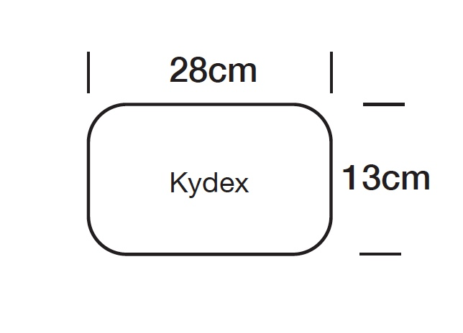
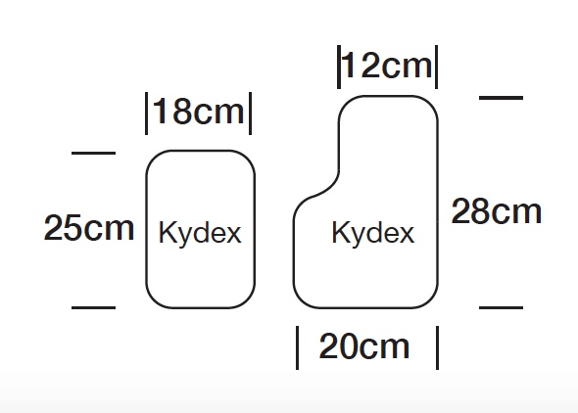
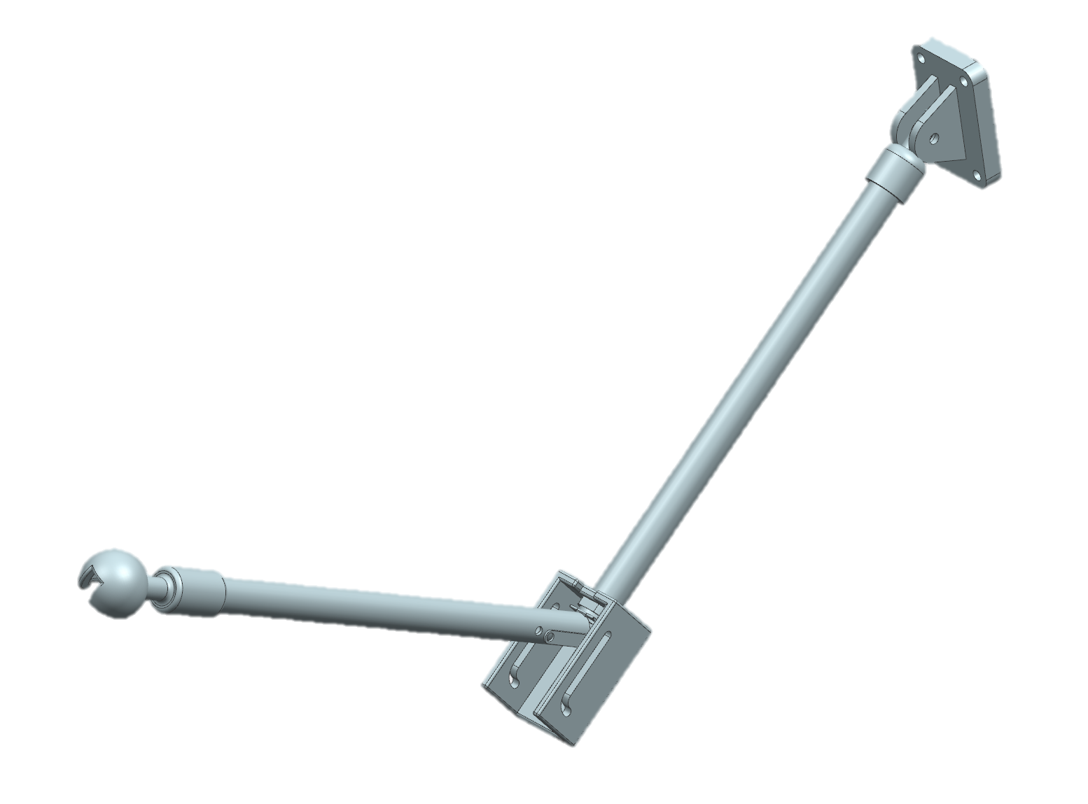
Initial Final Design
Front View
Side View
Back View
300mm
References: 5, 19, 20, 21, 22, 28.

Slide 13
Prototype Design
Three subsystems:
Inflation ( Arms)
Electrical
Vest Design

Slide 14
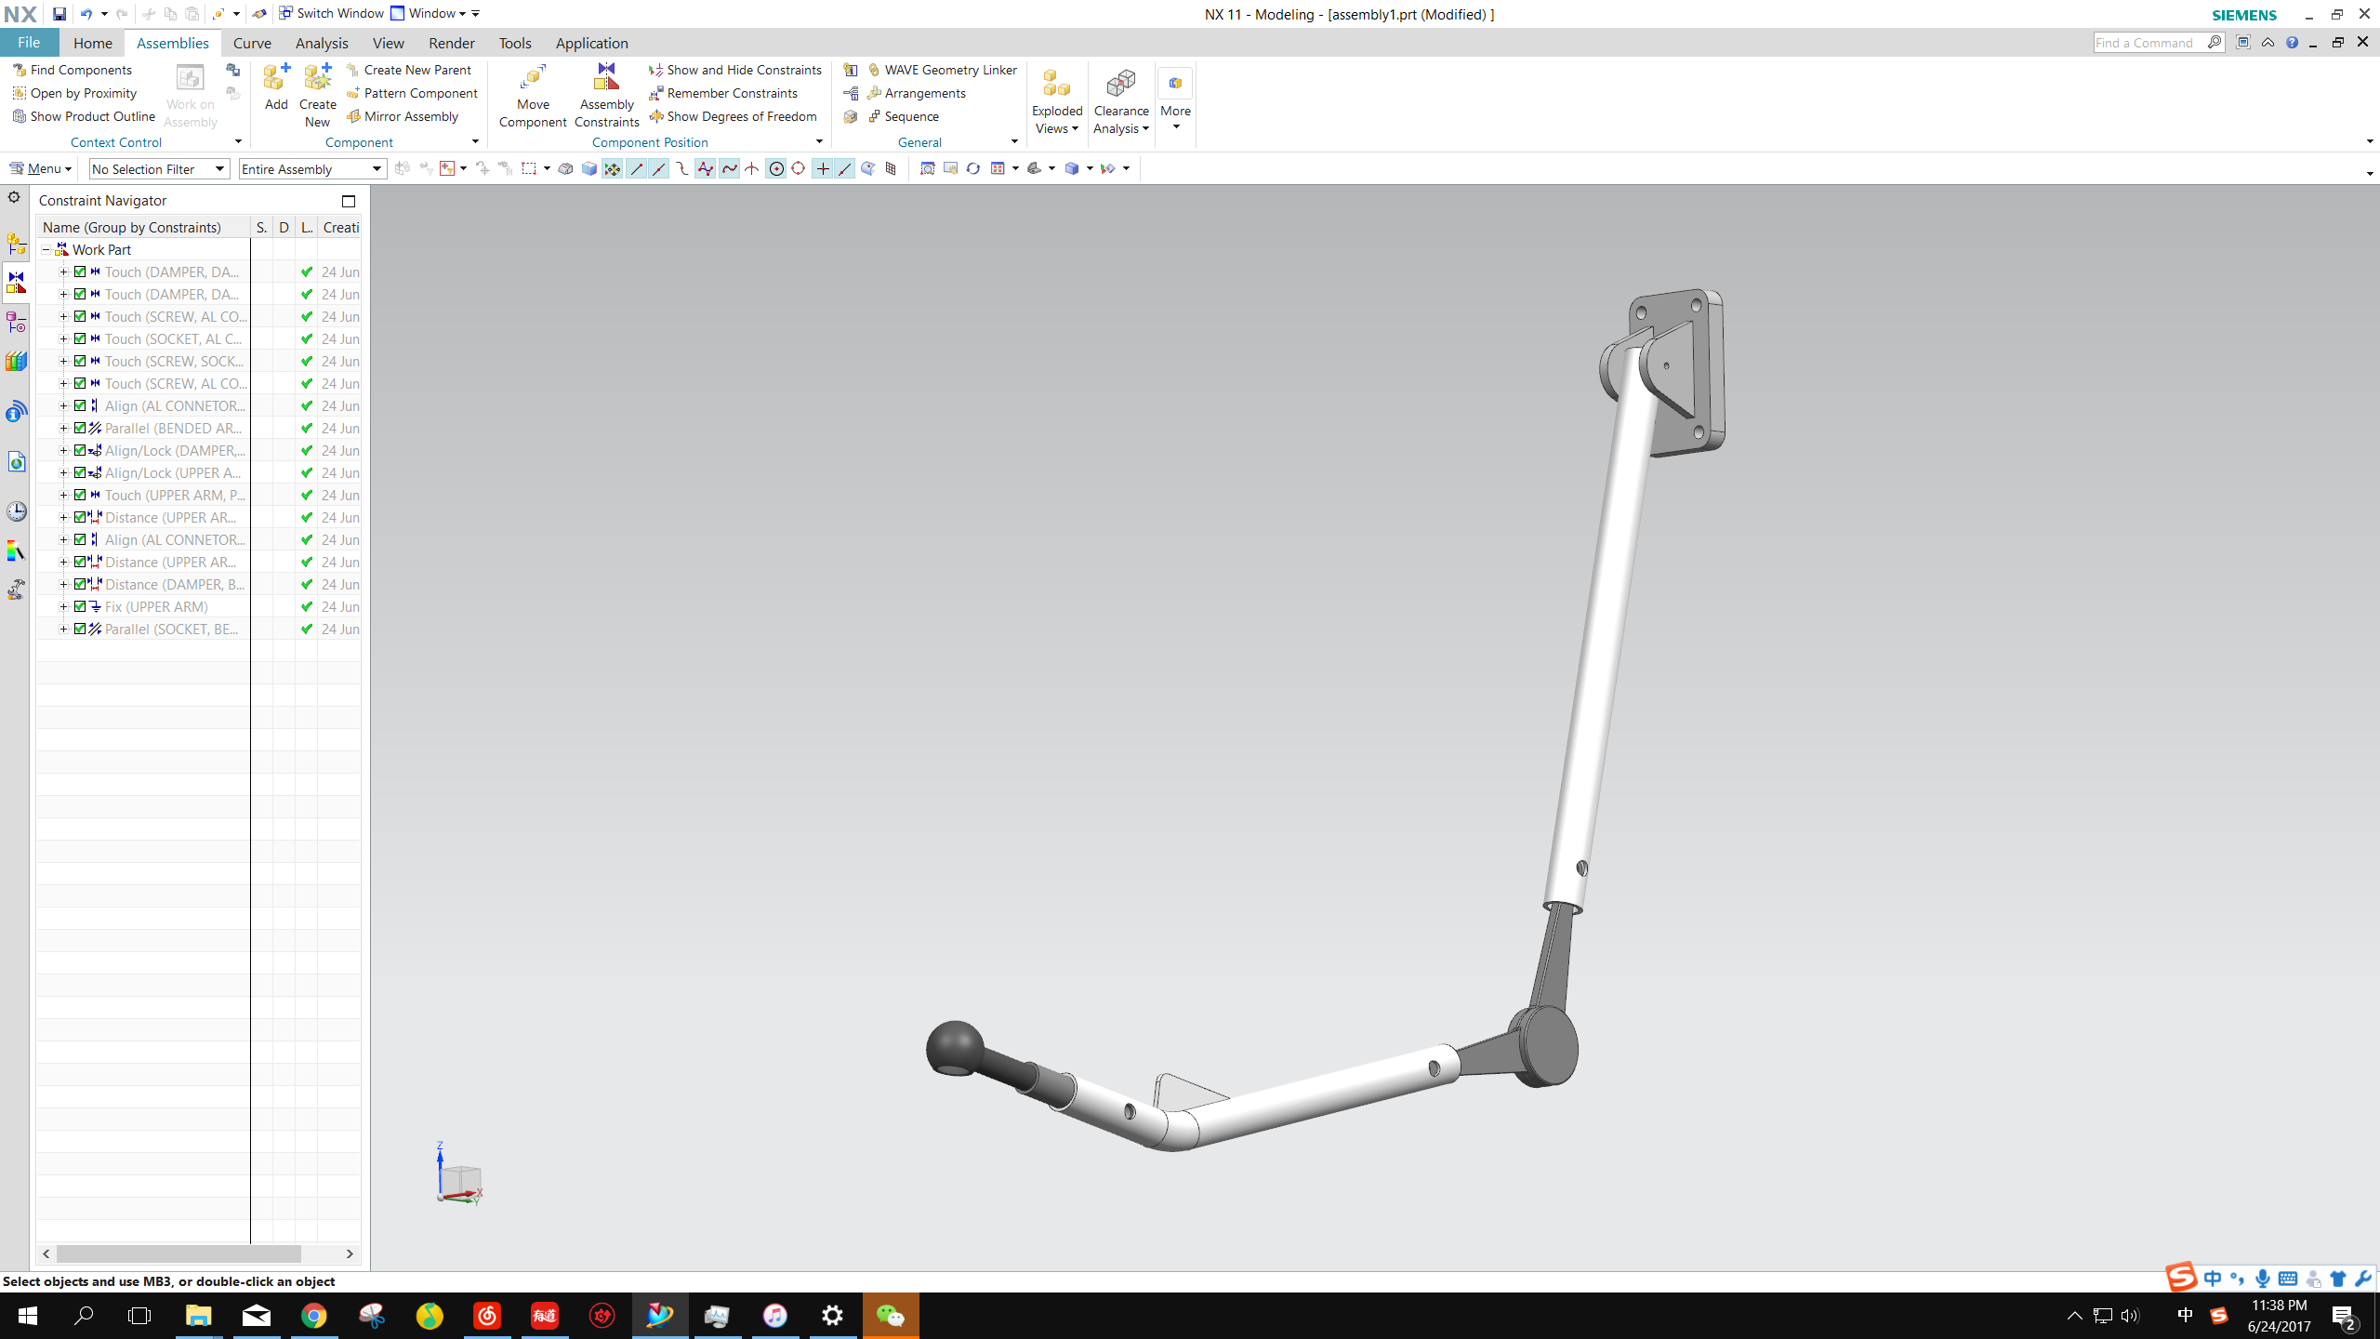
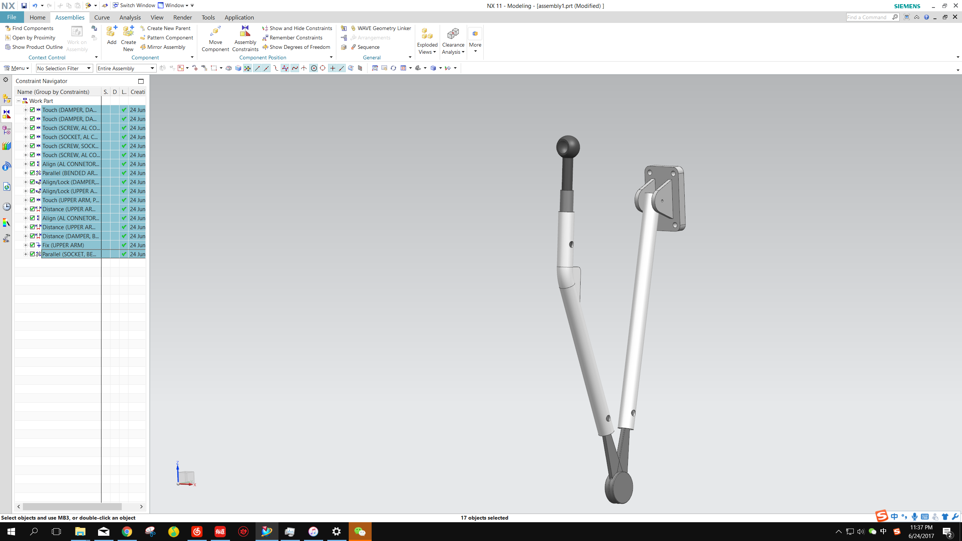
Prototype Arm Design
300mm (11 inches)
300mm (11 inches)
300mm (11 inches)

Slide 15
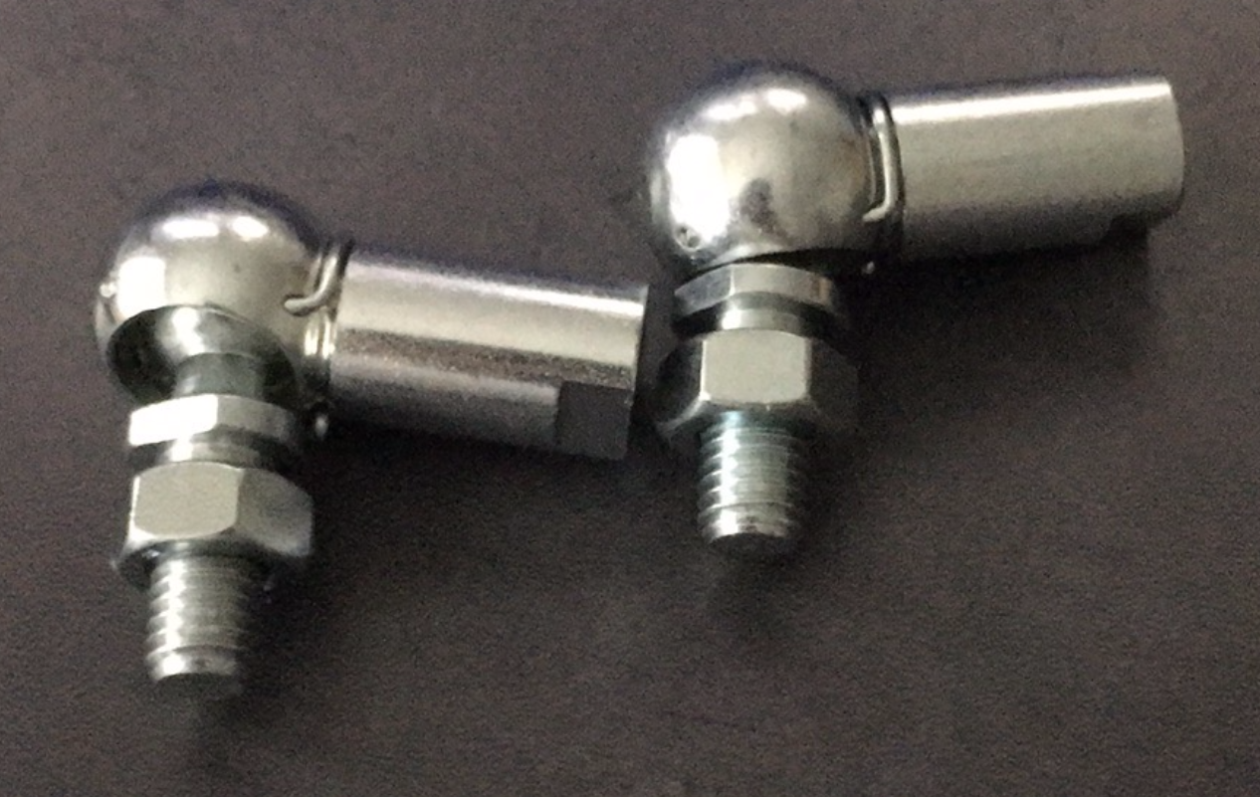
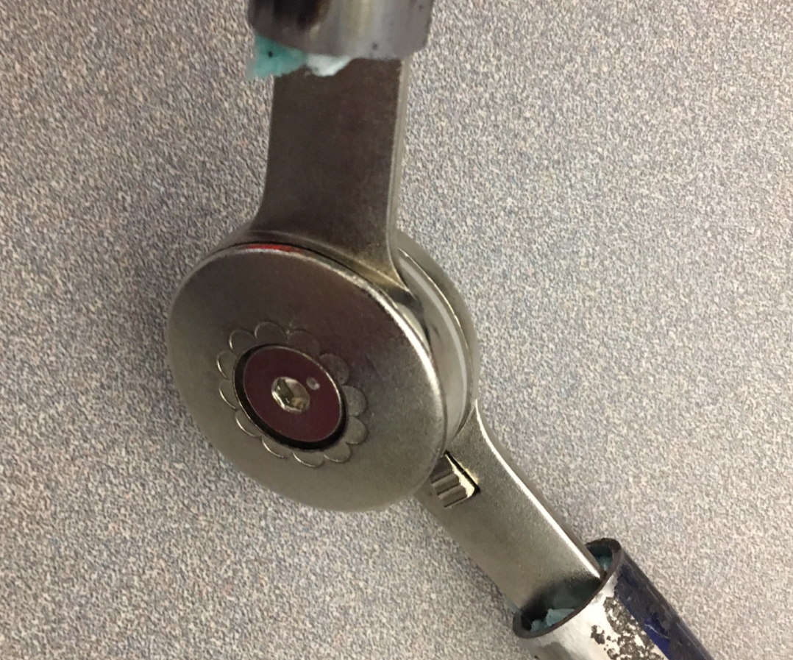
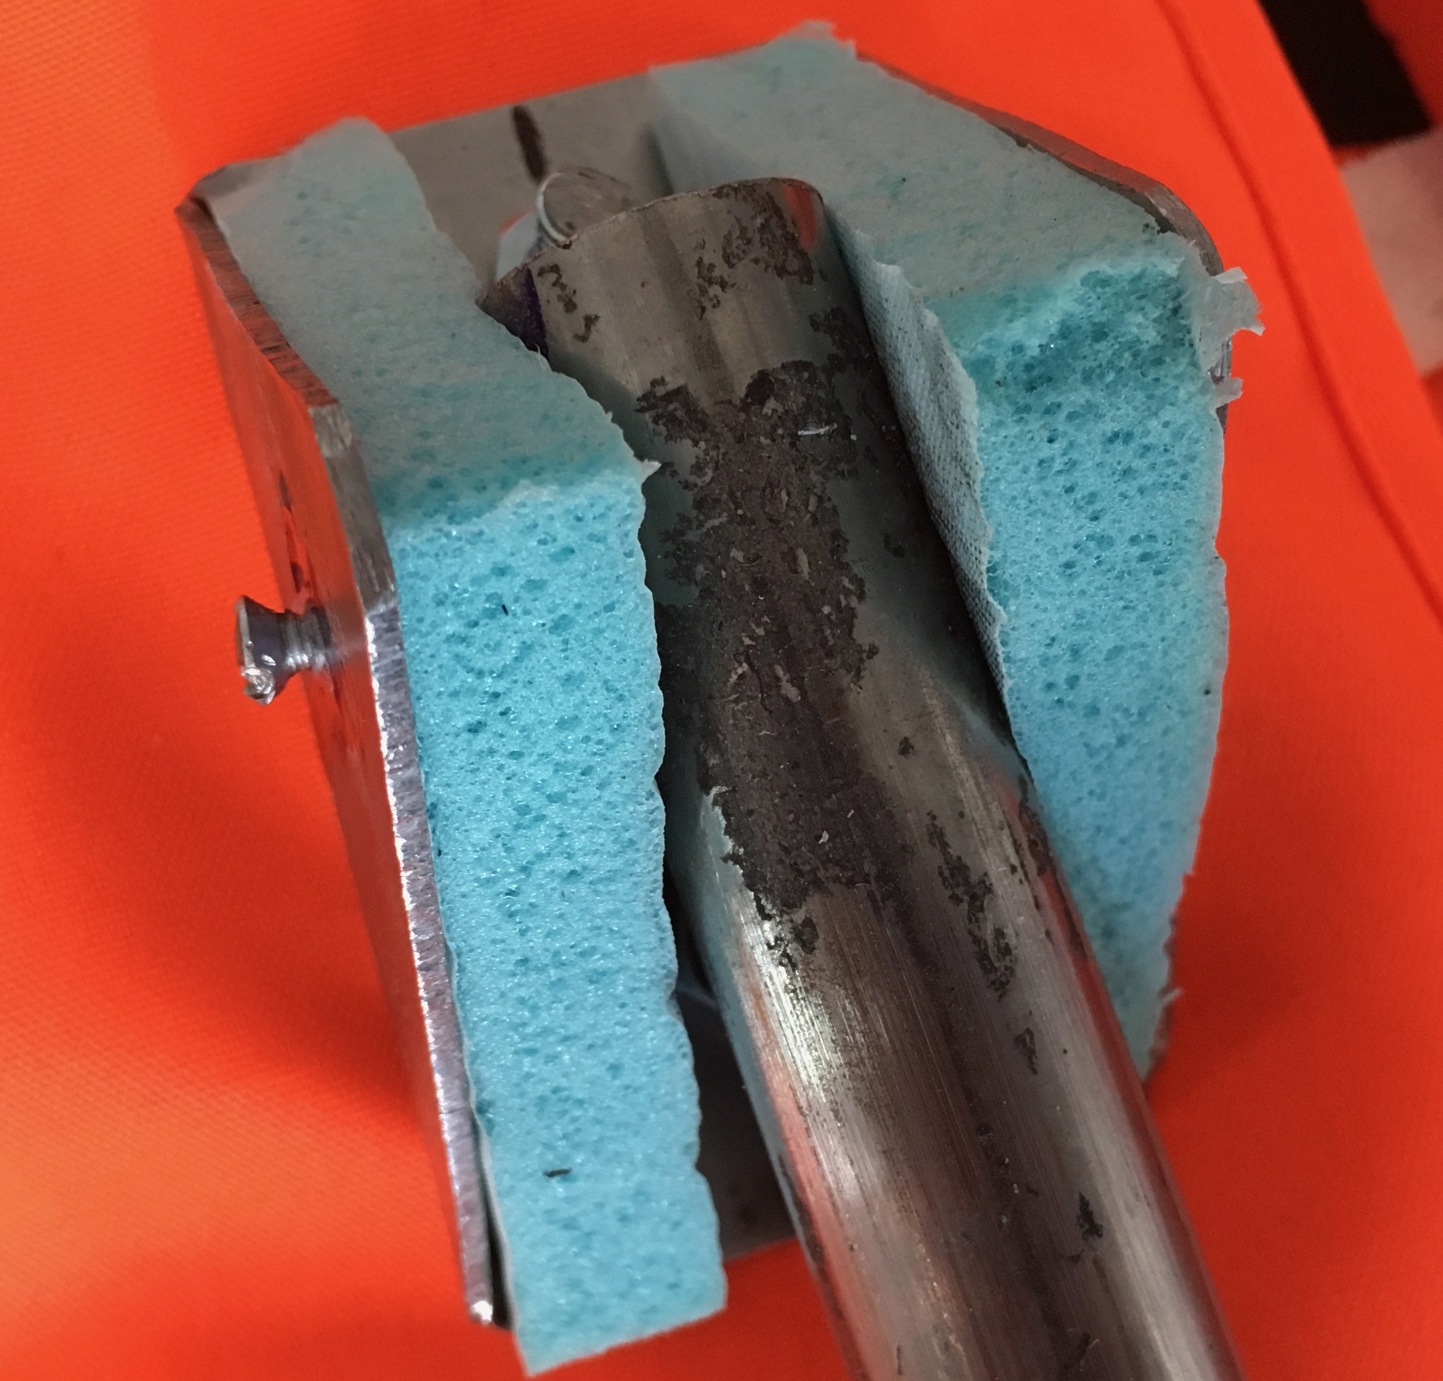
Prototype joint designs
 | Picture | Functionality
Ball & Socket |  | Freely adjusts contact angle with ground
Rotatory Damper |  | Opens freely Dampness prevents closing Opens to approximately 180 degrees
Pinned |  | Restricts left and right rotation
CAD picture needed

Slide 16
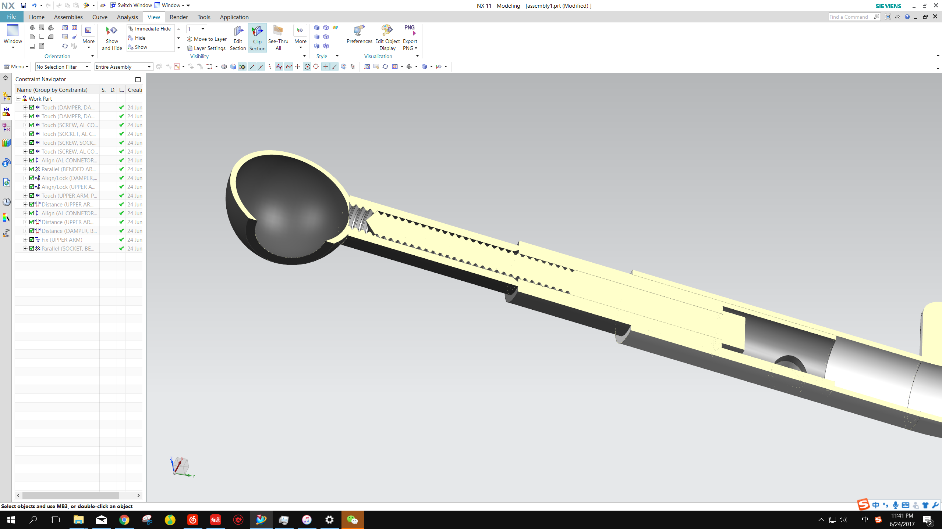
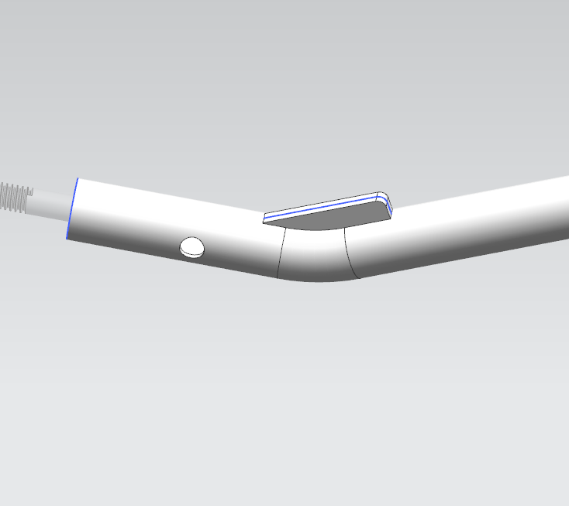
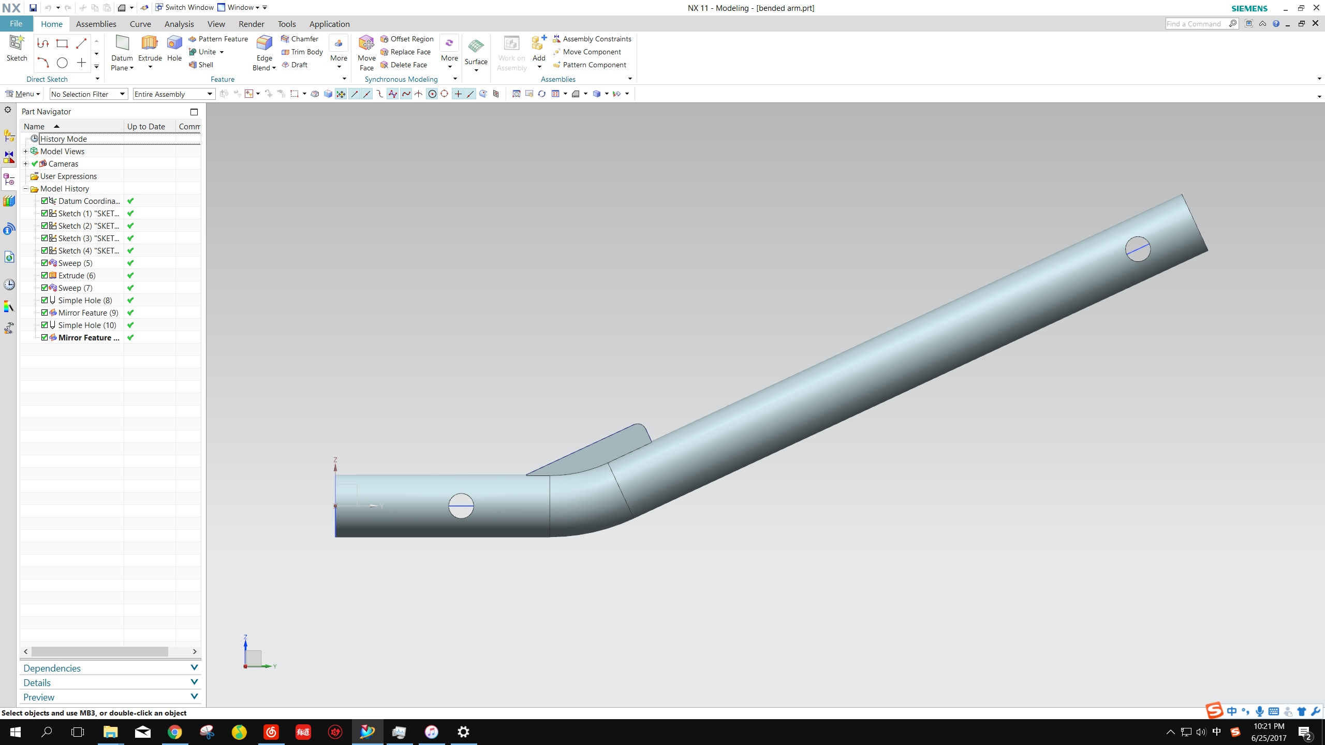
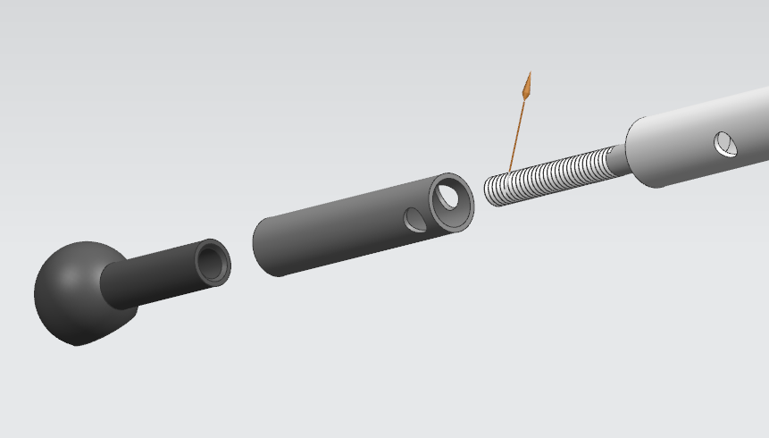
Prototype Arm design Details
Bended Lower-rods | Welded Support | Aluminum Connection Rod
CAD picture needed
25˚
Aluminum Rod

Slide 17
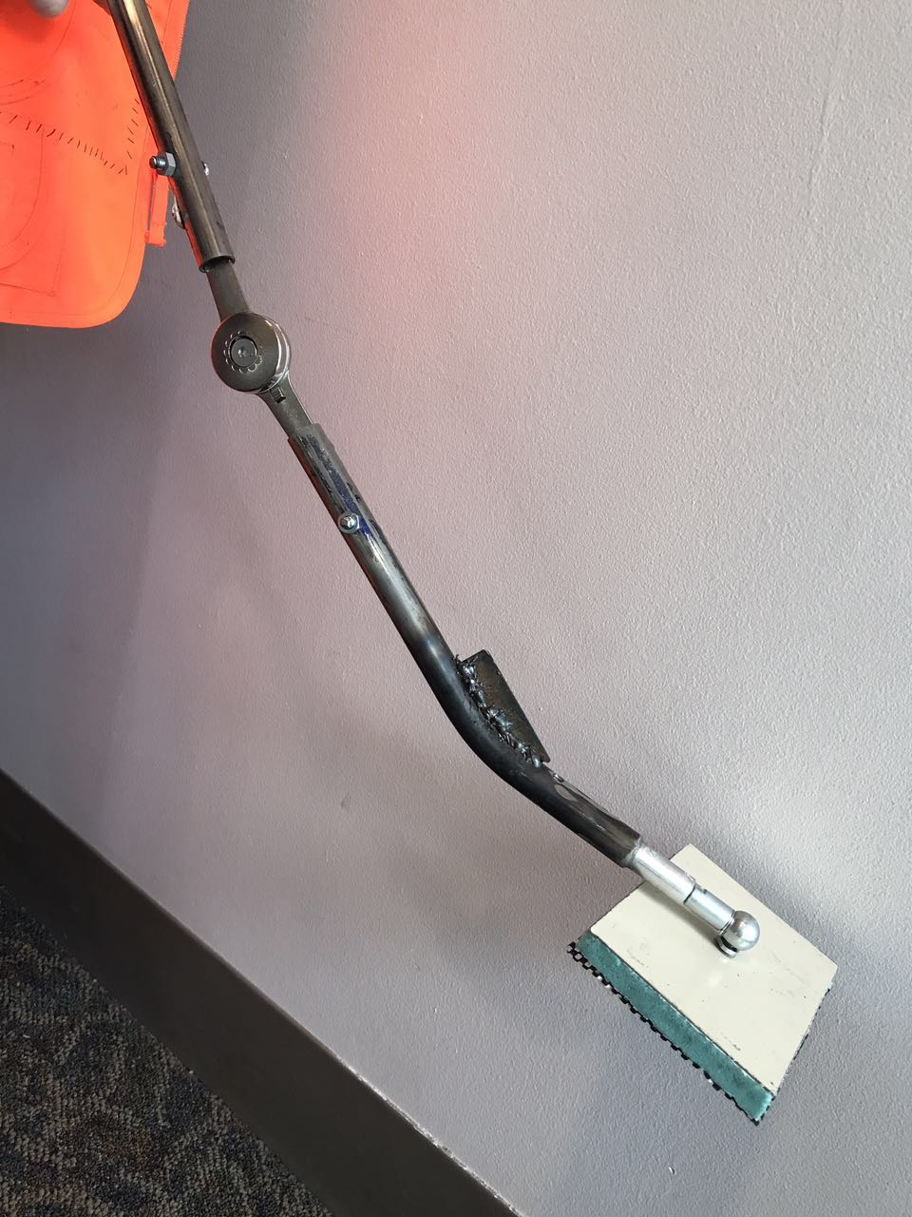
Prototype arm Assembly
Part | Manufacturing Steps | Equipment Used
Ball and Socket Joint | Buy joint Make connection | Drill press Lathe
Steel rods | Cut steel Drill holes Drill additional holes Bend steel Cut and weld gusset | Drill press Bending machine Acetylene/Oxygen torch MIG welding torch (low voltage)

Slide 18
Prototype Arm assembly
Part | Manufacturing Steps | Equipment Used
Pinned Joints | Cut steel sheets Drill holes Round edges Bend steel Attach foam | Shear Steel cutting band saw Drill press Belt sander Metal bender
Base Plates | Cut steel Cut and attach foam pieces Drill holes through foam and steel Attach rubber and cut holes for screws | Steel cutting band saw Scissors Knife Drill press Super glue
Screws | Cut to size | Bench vice Titanium carbide wheel Belt sander Files
References: 1, 15, 16, 37 42, 44.

Slide 19
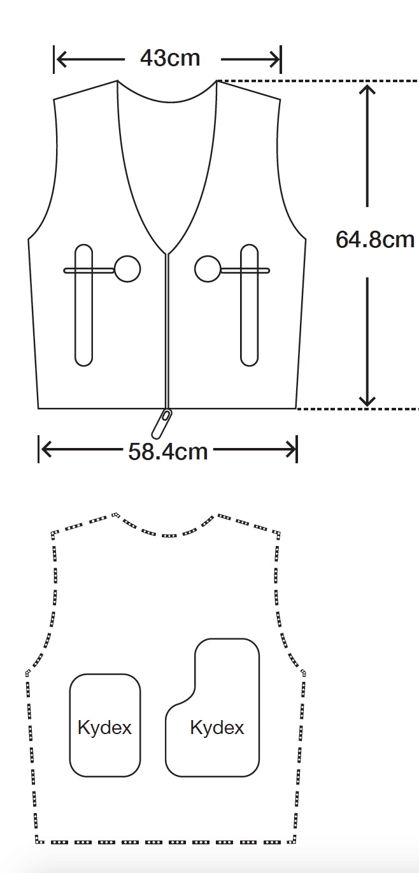
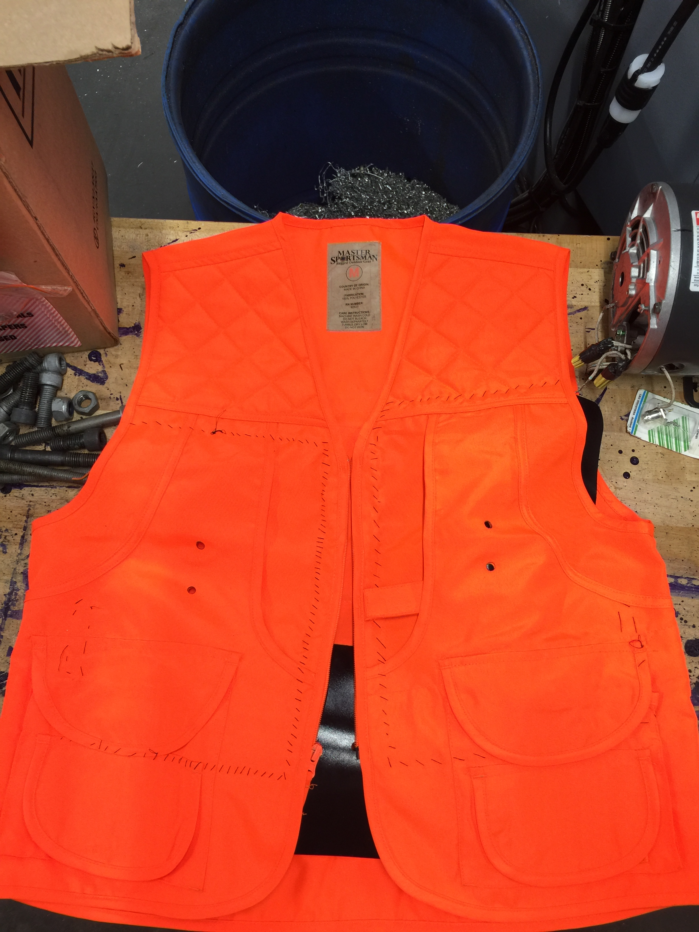
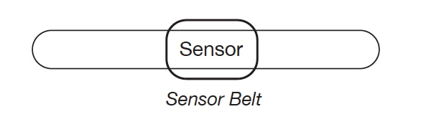
Prototype Vest design
References: 46, 47.

Slide 20
Prototype Vest assembly
Part | Manufacturing Steps | Equipment Used
Vest | Measure and cut Kydex plates Bend Kydex Sew pockets for Kydex Drill Kydex plates Laser cut vest holes Attach arms to Kydex Attach velcro | Band saw Heat gun Thread and Needles Hand drill Laser cutter Super glue
Trigger Hooks | Remove material to decrease hook curvature Attach to motor Cut and cauterize rope Sew onto vest | Belt sander Super glue Scissors Acetylene/Oxygen torch Needles and thread

Slide 21
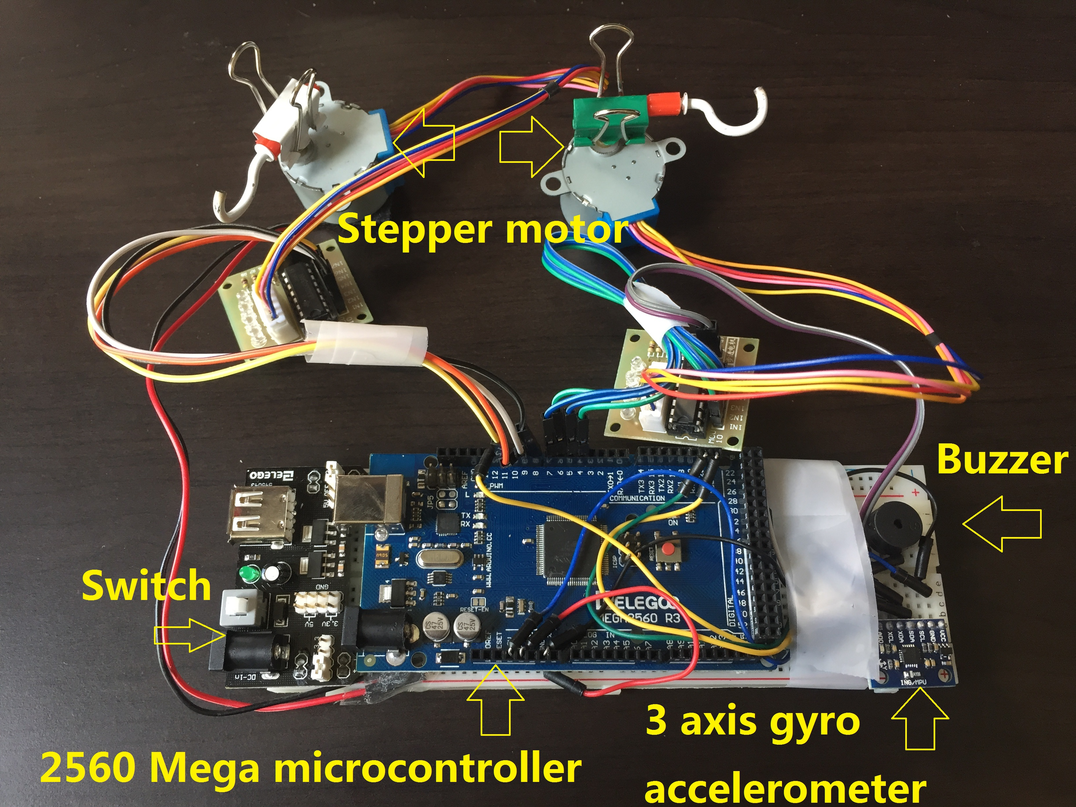
Prototype Electrical Design & Assembly
Stepper Motor
Buzzer
Switch
2560 Mega Microcontroller
3 axis gyro accelerometer
Battery

Slide 22
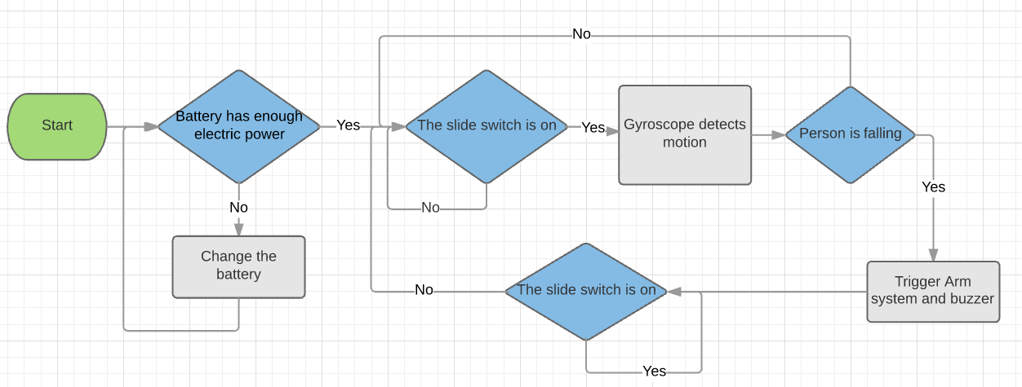
Electrical Design – logic diagram
Notes:
Pictures of circuit needed

Slide 23
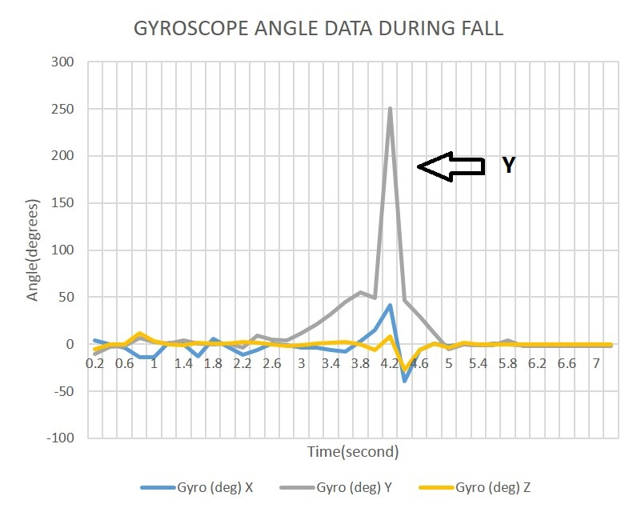
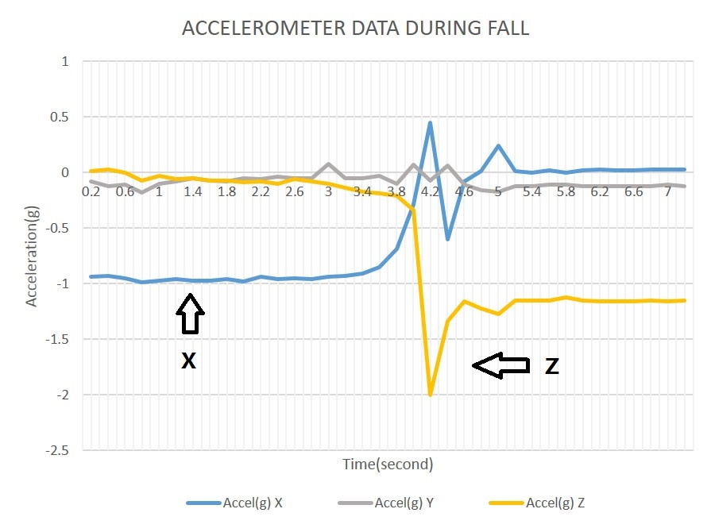
Sensor trigger data
 | Gyro Y(deg) | Accel X(g) | Accel Z(g)
Bend | 52.5 | 0.10 | 0.11
Walk | 10.0 | 0.10 | 0.06
Go upstairs | 17.5 | 0.28 | 0.01
Go Downstairs | 36.7 | 0.35 | 0.23
Fall | 90 | 0.30 | 0.43
Conclusion
Trigger data | 80 | 0.30 | 0.30
Horizontal Vertical Out of plane

Slide 24
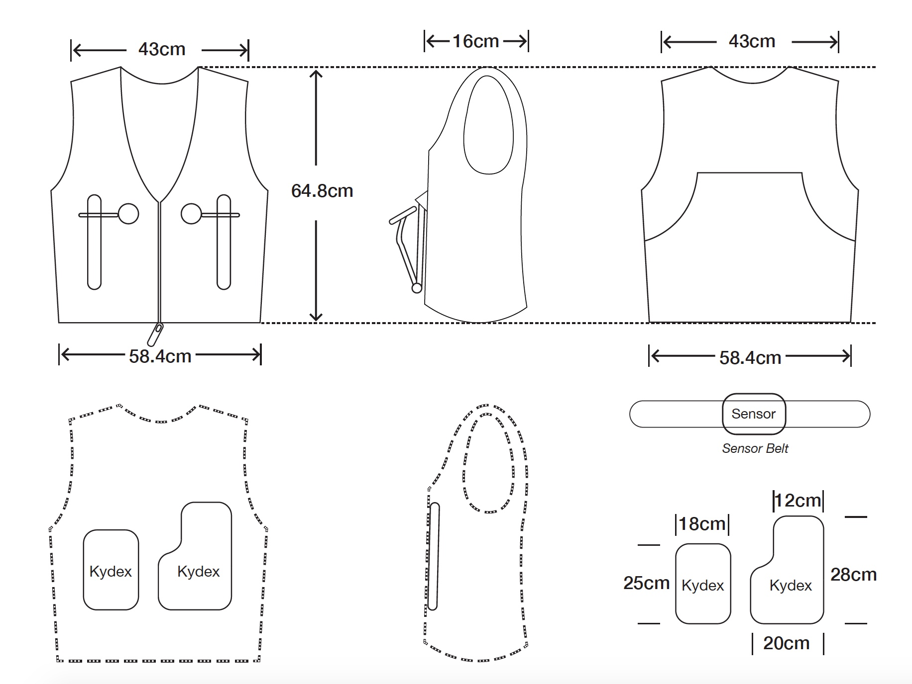
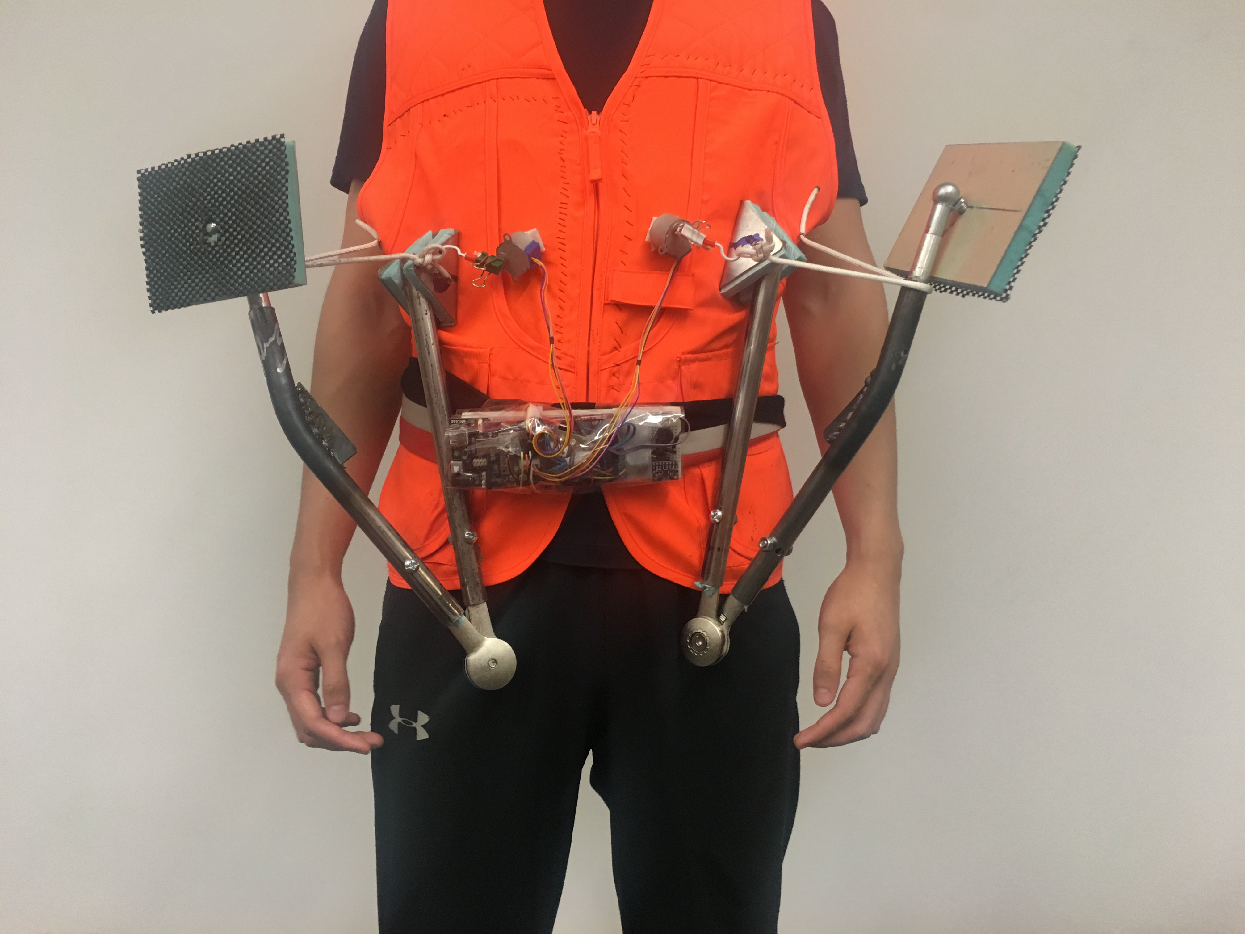
Prototype Design
Sketch of Prototype Design
Photo of Prototype Design

Slide 25
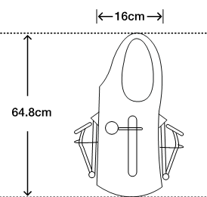
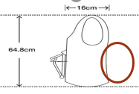
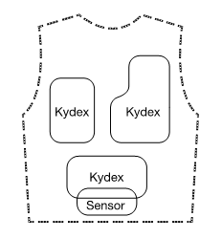
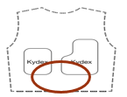


Comparison: Prototype and initial final design
 | Final design | Prototype
Number of arms | 6 arms | 2 arms
Max weight of users | 890 Newtons | 200 Newtons
Catch height | .91 meters | At least .3 meters
Color/Shape | Multiple color selections/Vest | Orange/Vest
Kydex plate | Stomach plate | No stomach plate
Sensor Placement | In vest pocket | On the belt
Mesh | Mesh inside the vest | Without mesh

Slide 26
Testing
Subsystem testing
System testing

Slide 27
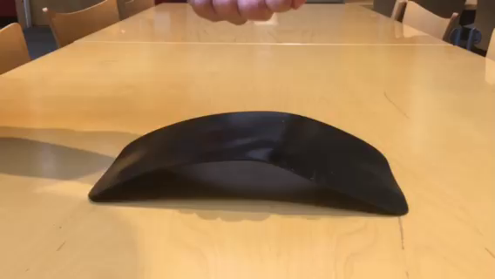
Subsystem Testing – design group
Design Group testing
Based on Calculation
Cannot do human body test
Jumped on the curved Kydex
No permanent deformation (without heat)
Not broken
Maintains shape
Punching a Kydex Plate

Slide 28
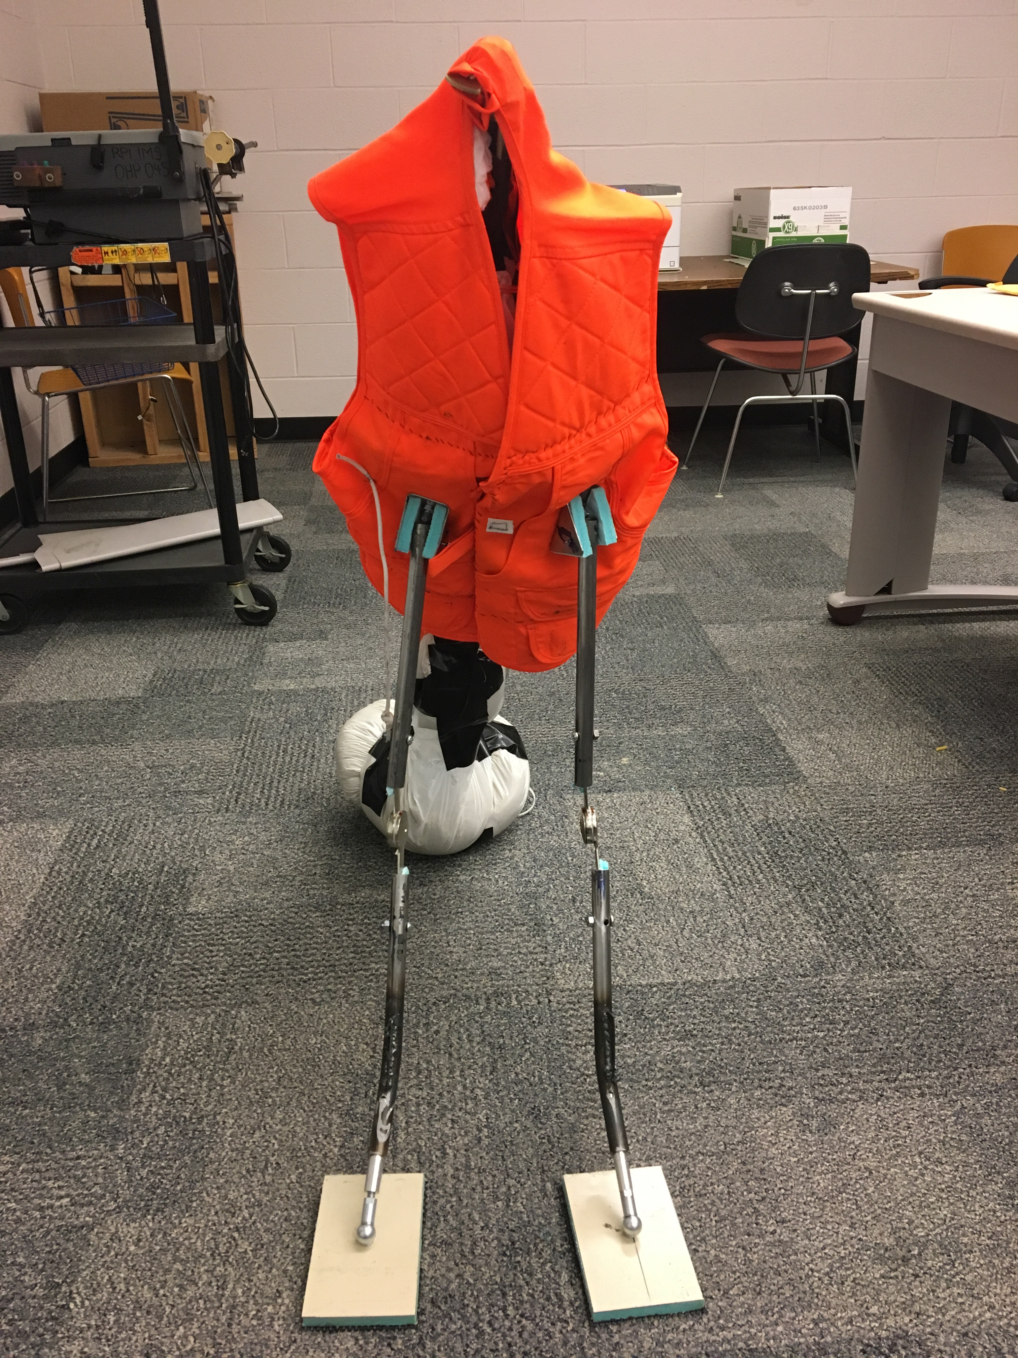
Subsystem Testing – arm group
Arm testing
Dummy falls down on carpet: 0.81s
Dummy falls down on floor: 0.90s
With arms on carpet: 1.88s
With arms on floor: 1.82s
Take-away: Consistently slows down a victim's fall
Arm Supporting the Dummy
Notes:
Consistently slows down a person’s falling by around 1s, which is critical
0.78s/0.91/0.74
0.96/0.80/0.96
1.83/2.81/2.10
2.03/1.73/1.69

Slide 29
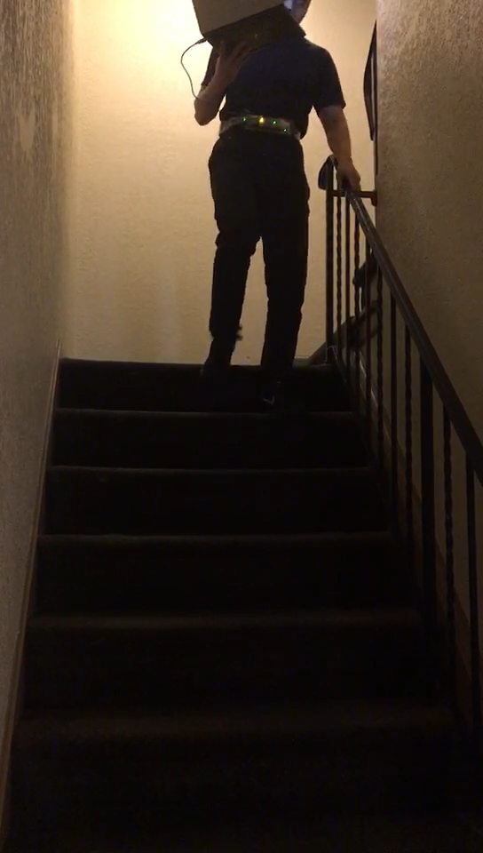
Subsystem Testing – electrical group
Circuit and sensor testing
Walking
Bending over
Walking upstairs
Walking downstairs
Falling down
Trigger Time: 0.56s
Testing Sensors by Walking Downstairs
Notes:
1.25 / 1.42 / 1.21

Slide 30
Prototype Testing
Fall → Sensor Trigger → Arm Deployment

Slide 31
Problems Encountered & solutions
Subsystems | Problems | Solutions
Electrical | Sensor and success rate： Loose pocket-bad readings Originally sensor worked intermittently. No area to place sensor(Kydex plates) Clip and hook kept falling. | Place sensor on a belt Super glue
Arm | Ball-and-socket joints did not bent to 45 degrees (ideal angle) Arm hinges loosened and dummy fell down quickly | Bend the steel rods Tighten hinges
Vest | Stomach Kydex plate did not fit - in way of sensor Velcro connecting motor to vest did not stick Zipper not simple enough for elderly | Remove stomach plate Change velcro type Use velcro to close vest

Slide 32
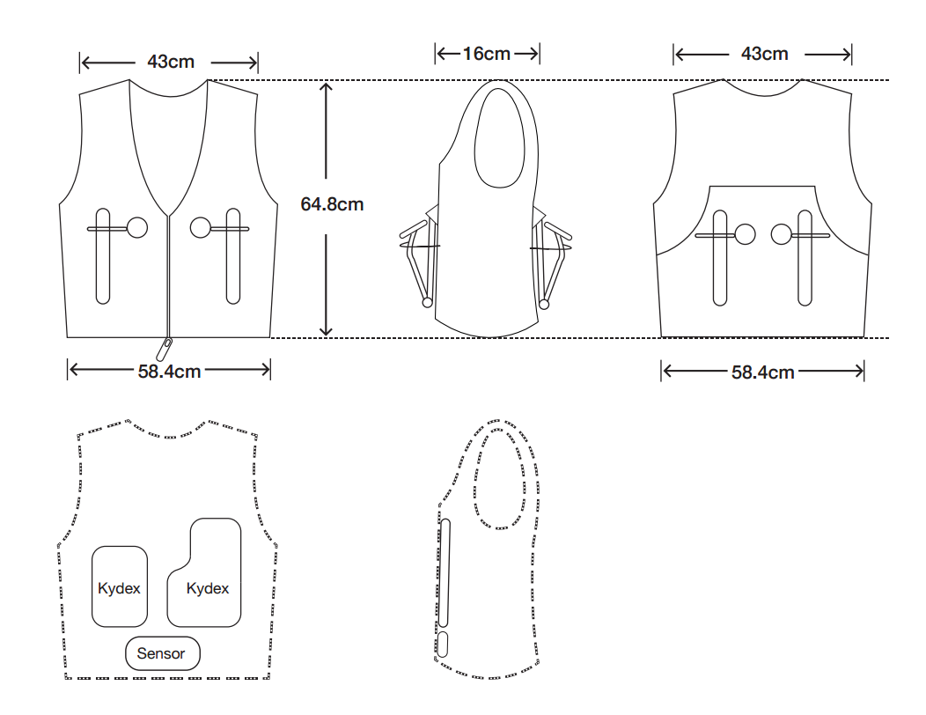
Updated Final Design
Initial Final Design

Slide 33
Production Ramp up
Use wedge lock joint
Make vest
Use ventilation foam
Increase friction of rubber coating bottom of base plates
Buy bulk materials
Each vest contains 4 legs
Increase availability of multiple colors and sizes
Increase motor speed and mount sensor inside vest
Use ball and socket joint with correct angle range (45 degrees)
Hire manufacturers
Use steel for ball and socket connection

Slide 34
Review & Reflect
Prototype is not at realistic standards for a fall
It will be in the future
Solvable prototype problems were corrected
Some prototype problems were not fixable
Reasons:
Time constraints
Money constraints
Differences between the initial final design and the updated final design:
Stomach plate removed
Catch height is decreased

Slide 35
Validation against customer needs - safety
Interpreted specifications | Final Design Requirement | Prototype Requirement | Prototype
Plate Location | stomach, shoulder, ribs, hips | stomach, ribs | Plate placement
Maximum Weight Limit | 890 Newtons | 200 Newtons | 200 Newtons
Sufficient Catch Height | .91 Meter | 0.3 meters | 0.3 meters
Arm deployment time | 1 second | 4 seconds | 1.3 seconds
Diameter of arm | 5.08 inches or less | 5.08 inches or less | 1.905 cm od 1.5875 cm id
References: 53

Slide 36
Validation against customer needs – comfortable and ease of use
Interpreted specifications | Final Design Requirement | Prototype Requirement | Prototype
Suitable Size | standard unisex sizes (in.) Medium - Chest (38-40), Waist - (32-33) | One size/ medium | One size/ medium
Suitable Weight | ≤ 9 Kg | ≤ 9 Kg | 2.27kg
Number of Assembly Parts | ≤ 10 parts | ≤ 10 parts | 2
Time to assemble | ≤ 20 minutes | ≤ 20 minutes | ≤ 20 minutes
Time to reassemble | ≤ 5 minutes | ≤ 5 minutes | ≤ 5 minutes
Time to put on | ≤ 3 minutes | ≤ 3 minutes | ≤ 3minutes
Percent Shrinkage | assuming washable, < 5% | assuming washable, < 5% | 0%
Percent Dampness | 0% water reaching sensors | 100% | 100%
Temperature Moderation | At least 4 holes, >3 ventilation areas additional | Without mesh | Without mesh

Slide 37
Validation against customer needs – Affordable & fashionable
Interpreted specifications | Final Design Requirement | Prototype Requirement | Prototype
Purchase cost | < $500 (subjective to change of cost analysis) | < $500 | $358.59
Color | Subjective | orange | orange
Shape | Subjective | vest | vest

Slide 38
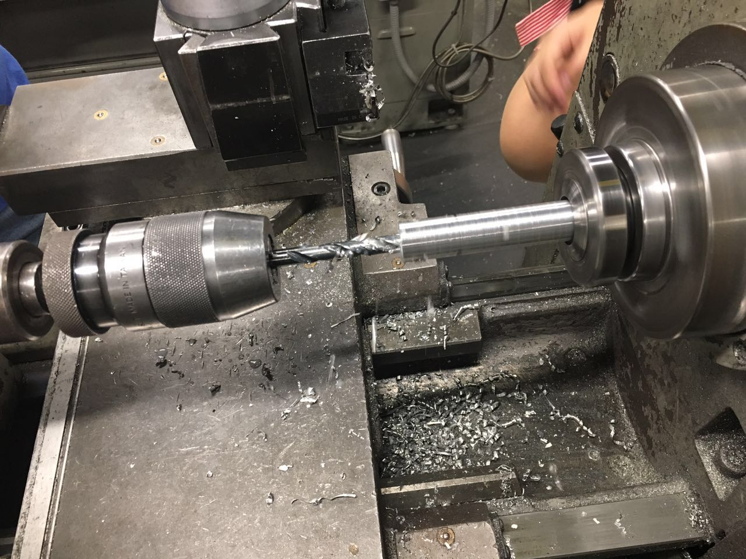

WHAT WE LEARNED
[8]
[13]
Machining techniques
Communication& Teamwork
[43]
Problem solving skills
Engineering Design process
Notes:
Engineering process picture https://www.teachengineering.org/k12engineering/designprocess

Slide 39
conclusion
To end: This is not getting better.
Cost of falls estimated to double by 2020.
Products on the market can’t stop falls.
Begin production ramp-up to manufacture larger quantities of the vest.
Primary Customer : patients and elderly people from nursing homes, hospitals, and eventually civilians once cost goes down.
References: 31.
Notes:
Update gantt chart

Slide 40
References
1. A. (n.d.). Material Selection Guide. Retrieved June 08, 2017, from http://www.applerubber.com/seal-design-guide/material-selection-guide/hydrogenated-nitrile.cfm ​
2. A. (n.d.). Retrieved June 08, 2017, from https://www.arduino.cc/en/Products/Compare
3. A. (n.d.). Suspa C16-08054 C1608054 20" Gas Prop, Quantity (2), Force 100 Lbs Per Prop, Force Per Set 200 Lbs, Camper Rear Window, Tonneau Cover Lift Supports, Window Lift Support, Made in USA: Automotive. Retrieved June 12, 2017, from https://www.amazon.com/Suspa-C16-08054-C1608054-Quantity-Supports/dp/B0041EBSX4/ref=sr_1_3?ie=UTF8&qid=1497298917&sr=8-3&keywords=gas%2Bspring​
4. Agency, V.( n.d.). PVC. Retrieved June 08, 2017, from http://www.pvc.org/en/p/pvcs-physical-properties​
5. Apparel, A. (n.d.). Size Chart: Men/Unisex Shirts. Retrieved June 12, 2017, from https://www.americanapparel.net/sizing/default.asp?chart=mu.shirts​
6. AT&T.(n.d.). AARP Recommendations. Retrieved June 08, 2017, from https://www.att.com/att/InnovationStore/images/products/everthere/docs/AARP.pdf​​
7. AT&T ForHealth EverThere alerts, guides emergency medical teams. (n.d.). Retrieved June 08, 2017, from https://www.slashgear.com/att-forhealth-everthere-alerts-guides-emergency-medical-teams-04307646/8.
8. Communication [Digital image]. (n.d.). Retrieved June 25, 2017, from http://blogs.oregonstate.edu/programevaluation/2017/04/17/communication/
9. C. (n.d.). Custom Advanced Connections. Retrieved June 08, 2017, from http://www.customadvanced.com/common-properties-of-rubber-elastomers.html​
10. D. (n.d.). Sensor Requirements for Human Fall Detection Systems. Retrieved June 08, 2017, from https://www.digikey.com/en/articles/techzone/2012/dec/sensor-requirements-for-human-fall-detection-systems​
11. Double Channel LM393 Tilt Slant Angle Sensor Module DC 3.3V-12V. (n.d.). Retrieved June 26, 2017, from https://www.amazon.com/Double-Channel-Sensor-Module-3-3V-12V/dp/B00HGAL2SQ

Slide 41
References
12. E. (n.d.). Sports Mesh Fabric [Digital image]. Retrieved June 12, 2017
13. Engineering Design Process [Digital image]. (n.d.). Retrieved June 25, 2017, from https://www.teachengineering.org/k12engineering/designprocess.
14. Feynman, R., Gottlieb, M., Leighton, R. (2013). Feynman's Tips on Physics, A Problem-Solving Supplement to the Feynman Lectures on Physics. Basic Books.
15. Goodrich, R. (2013, October 01). Accelerometer vs. Gyroscope: What's the Difference? Retrieved June 08, 2017, from https://www.livescience.com/40103-accelerometer-vs-gyroscope.html
16. Group, S. (n.d.). Properties of aluminium. Retrieved June 08, 2017, from http://www.aluminiumdesign.net/why-aluminium/properties-of-aluminium/
17. Gyroscope. (2017, June 06). Retrieved June 08, 2017, from https://en.wikipedia.org/wiki/Gyroscope
18. H. (2017, March 28). Technology for fall prevention: Smart Slippers | HTS Therapy. Retrieved June 08, 2017, from https://www.htstherapy.com/technology-fall-prevention-smart-slippers/
19. Halls, D. (2017, June 10). Average weight chart and average weight for men by age. Retrieved June 14, 2017, from http://halls.md/average-weight-men/
20. Halls, D. (2017, June 13). Average weight for women, height weight charts. Retrieved June 14, 2017, from http://halls.md/average-weight-women/
21. Height Percentile Calculator, by Age or Country. (2016, May 06). Retrieved June 12, 2017, from https://tall.life/height-percentile-calculator-age-country/

Slide 42
References
22.Hoekstra, R. (2016, September 15). My top five fabrics for clothing. Retrieved June 08, 2017, from http://www.made-by-rae.com/2013/07/my-top-five-fabrics-for-clothing/
23. I. (n.d.).Bijal Textiles [Digital image]. Retrieved June 12, 2017.
24. Kerkar, P., MD. (2017, May 26). Complete Displaced Fracture of Knee Joint [Digital image]. Retrieved June 25, 2017, from https://www.epainassist.com/joint-pain/knee-pain/knee-joint-fracture
25. KYDEX-T_Data [Advertisement]. (2011). Retrieved June 15, 2017, from https://www.professionalplastics.com/professionalplastics/KYDEX-T_Data.pdf
26. L. (n.d.). LIFE ALERT official website - I've fallen and I can't get up!®. Retrieved June 08, 2017, from http://www.lifealert.com/
27. M. (n.d.). Hip Fracture [Digital image]. Retrieved June 25, 2017, from http://www.massgeneral.org/conditions/condition.aspx?id=223
28. Master, M. A. (1960, February 13). TABLES OF AVERAGE WEIGHT AND HEIGHT OF AMERICANS AGED 65 TO 94 YEARS. Retrieved June 14, 2017, from http://jamanetwork.com/journals/jama/article-abstract/327589
29. MatWeb. (n.d.). Retrieved June 12, 2017, from http://www.matweb.com/search/QuickText.aspx
30. Medical Alert Devices with Fall Detection| Medical Alert Systems Medical Alert Advice. (2015, November 29). Retrieved June 08, 2017, from http://www.medicalalertadvice.com/fall-detection/
31. NCOA. (2017, May 31). Falls Prevention Facts. Retrieved June 08, 2017, from https://www.ncoa.org/news/resources-for-reporters/get-the-facts/falls-prevention-facts/

Slide 43
References
32. Newsroom. Retrieved June 12, 2017, from https://www.census.gov/newsroom/facts-for-features/2016/cb16-ff08.html
33. O. (n.d.). OnCare smarter products. Better perfomance. Retrieved June 08, 2017, from http://www.oncaremedical.com/products/fallProducts.oncare?type=fall
34. O'brien, D. P., Luchette, F. A., Pereira, S. J., Lim, E., Seeskin, C. S., James, L., . . . Frame, S. B . (2002, October). Pelvic fracture in the elderly is associated with increased mortality. Retrieved June 08, 2017, from https://www.ncbi.nlm.nih.gov/pubmed/12407356
35. Office, A. T. (2008, July 16). Balance problems? Step into the iShoe. Retrieved June 08, 2017, from http://news.mit.edu/2008/i-shoe-0716
36. Plastics, I. (n.d.). KYDEX PRE-CUT 2X4 FT. BUNDLES [Digital image]. Retrieved June 12, 2017.
37. Polymer database.com, C. %. (n.d.). Polymer Properties Database. Retrieved June 08, 2017, from http://polymerdatabase.com/Elastomers/HNBR.html
38. Preece, J. (2017, May 03). The Best Fall Detection Sensors | Top Ten Reviews. Retrieved June 08, 2017, from http://www.toptenreviews.come/health/senior-care/best-fall-detection-sensors/
39. Proxy, I. S. (2015, April 10). Physical Properties of Rubber – a Buyer and Designer's Guide . Retrieved June 08, 2017, from http://www.azom.com/article.aspx?ArticleID=11914
40. Rubber Materials & Elastomer Compound Information. (n.d.). Retrieved June 08, 2017, from http://www.columbiaerd.com/materials.html
41. S. (2012, August 27). 10 Shocking Statistics About Elderly Falls. Retrieved June 08, 2017, from http://shellpoint.org/blog/2012/08/13/10-shocking-statistics-about-elderly-falls/
42. S. (n.d.). Gyroscope. Retrieved June 08, 2017, from https://learn.sparkfun.com/tutorials/gyroscope

Slide 44
REFERENCES
43. Spacial problem solving approach [Digital image]. (n.d.). Retrieved June 25, 2017, from https://learn.arcgis.com/en/related-concepts/spatial-problem-solving-approach.htm
44. Standard Drill Sizes - Inches. (n.d.). Retrieved June 12, 2017, from http://www.gearhob.com/eng/design/drill_eng.htm
45. T. (n.d.). MPU-6050 | TDK. Retrieved June 08, 2017, from https://www.invensense.com/products/motion-tracking/6-axis/mpu-6050/
46. Toolbox, E. (n.d.). Material Properties. Retrieved June 08, 2017, from http://www.engineeringtoolbox.com/material-properties-t_24.html
47. Toolbox, E. (n.d.). Polymers - Physical Properties. Retrieved June 08, 2017, from http://www.engineeringtoolbox.com/polymer-properties-d_1222.html
48. Toolbox, E. (n.d.). Thermoplastics - Physical Properties. Retrieved June 08, 2017, from http://www.engineeringtoolbox.com/physical-properties-thermoplastics-d_808.html
49. US Census Bureau Public Information Office. (2016, May 19). Newsroom Archive. Retrieved June 12, 2017, from https://www.census.gov/newsroom/releases/archives/miscellaneous/cb12-134.html
50. Uxcell® 15Pcs DC 5V 85dB Industrial Active Electronic Alarm Buzzer: Automotive. (n.d.). Retrieved June 26, 2017, from https://www.amazon.com/uxcell-Industrial-Active-Electronic-Buzzer/dp/B016FCBBT0/ref=sr_1_4?ie=UTF8&qid=1498412942&sr=8-4&keywords=buzzer
51. V. (n.d.). Technical illustration of a three-layer fabric. [Digital image]. Retrieved June 12, 2017
52. W. (n.d.). Falls. Retrieved June 08, 2017, from http://www.who.int/mediacentre/factsheets/fs344/en/
53. Wentworth, K. (2012, August 21). How Much Force Can Our Bones Handle Before They Break. Retrieved June 12, 2017, from http://ezinearticles.com/?How-Much-Force-Can-Our-Bones-Handle-Before-They-Break&id=7242657

Slide 45
Thank you!

Slide 46
Questions?

Slide 47
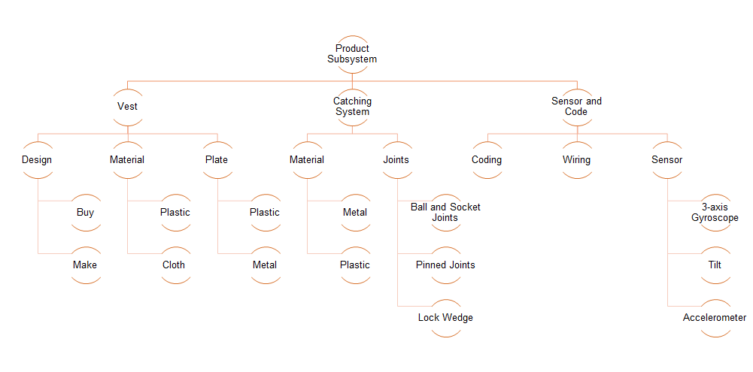
Appendix A :Product Subsystems
Notes:
No reference

Slide 48
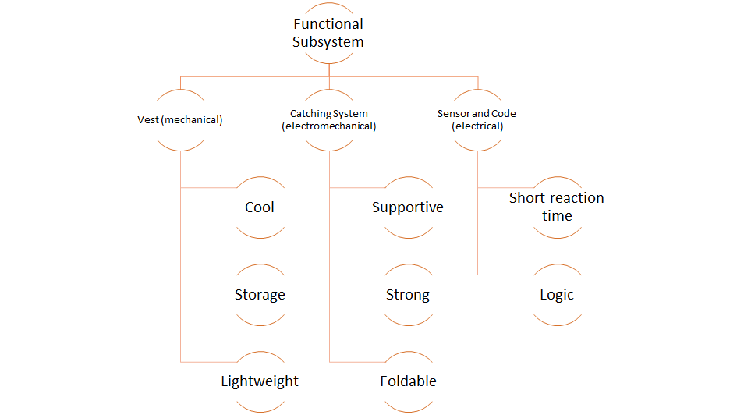
Appendix B : Functional Subsystems
Notes:
No reference

Slide 49
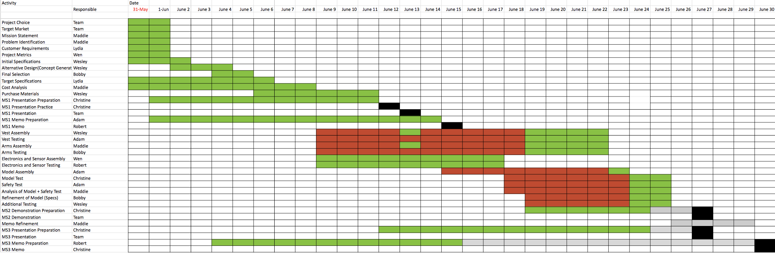
Appendix C : Gantt Chart
Notes:
No reference

Slide 50
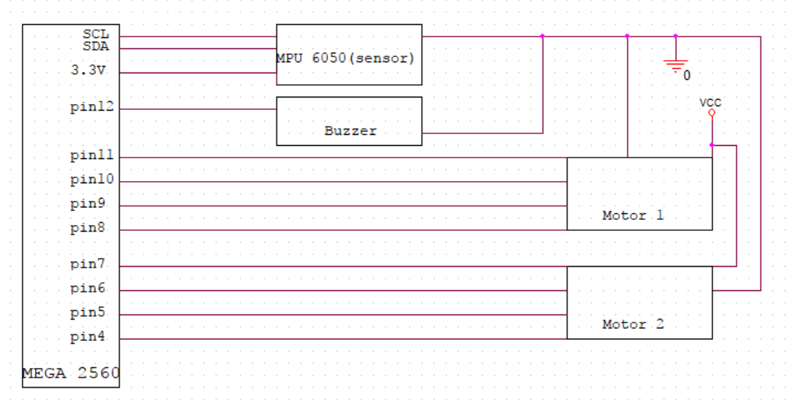
Appendix d– Circuit Diagram

Slide 51
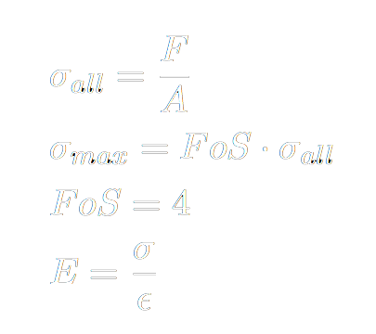
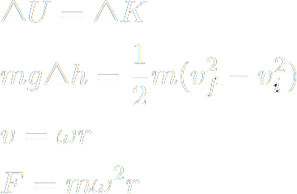
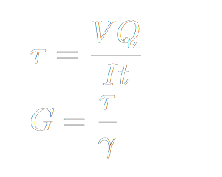
Appendix e - Calculations for Arms
Falling Force:
Stresses in Arm:
Stresses in Joints:
E (Young's Modulus) = 45 GPa, G (Shear Modulus) = 52 GPa
References: 14, 29.

